Slide 1
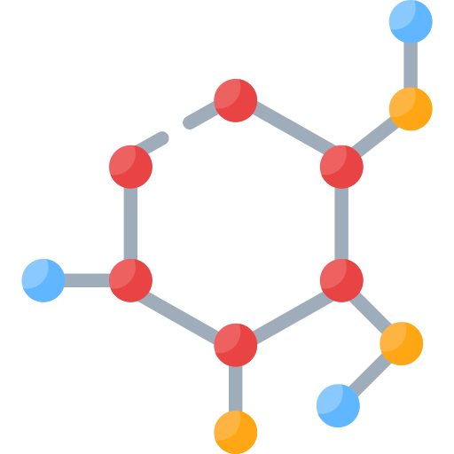

Computational biology
Protein Identification

Slide 2

> Team members:
Amgad montaser
Ali Abdelkader
Naira anwer
Nada allam
Myhan hassan
Aya abdelghafar
Nansy edward

Slide 3

Description:
our raw files is about various cancer types
- Retinoblastoma -lung -prostate
We compared theoretical spectrum from uniport (Fasta file) with 14 raw files

Slide 4
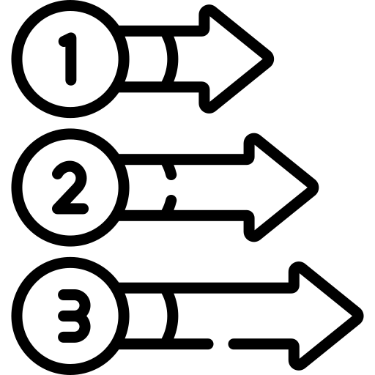
Steps:
First, the fragmentation of experimental spectrum
Second, finding peptide hits between experimental and theoretical spectrum
Third, alignment of matched peaks
Fourth, using mirror plot to visualize the matched peaks

Slide 5

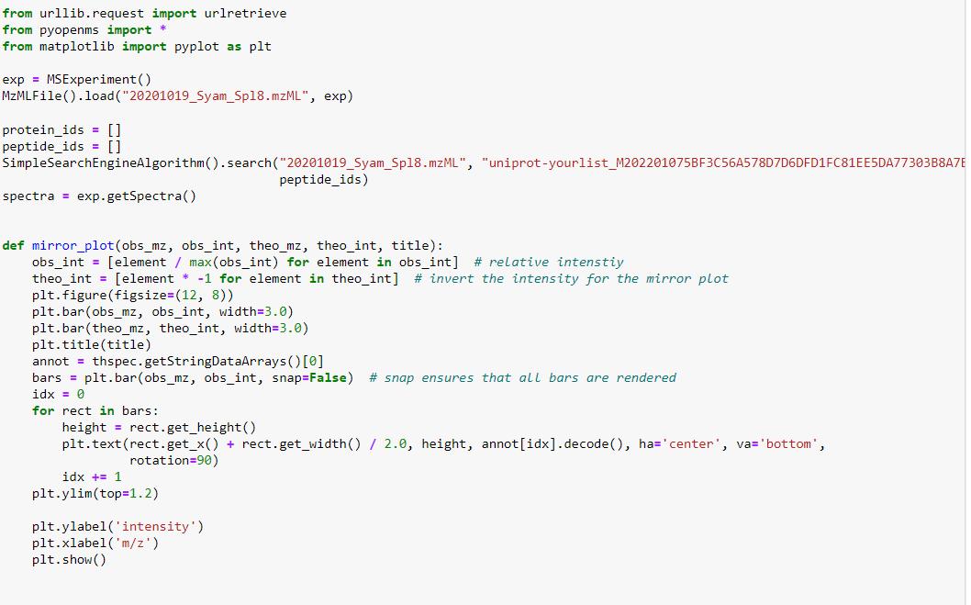
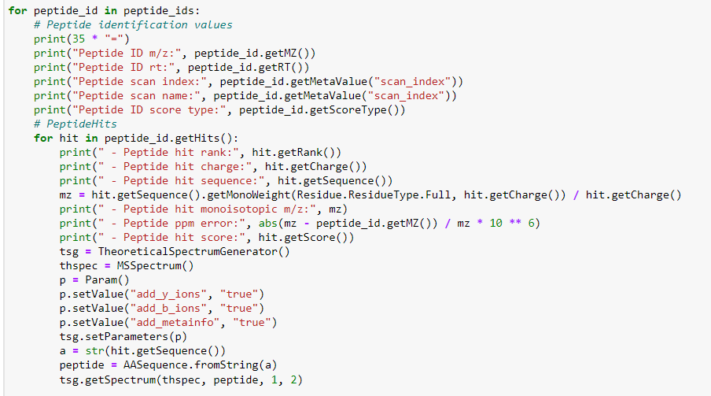
Code:

Slide 6
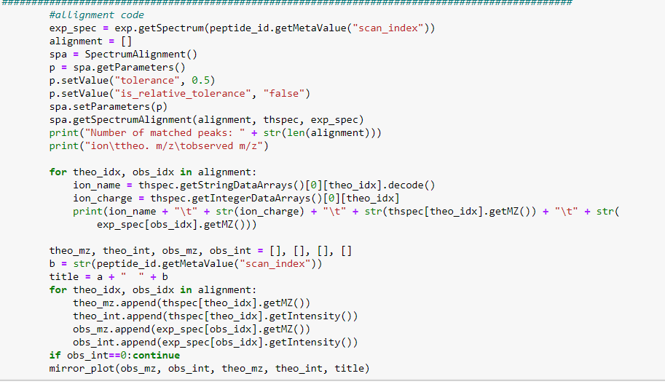

Slide 7

Results

Slide 8
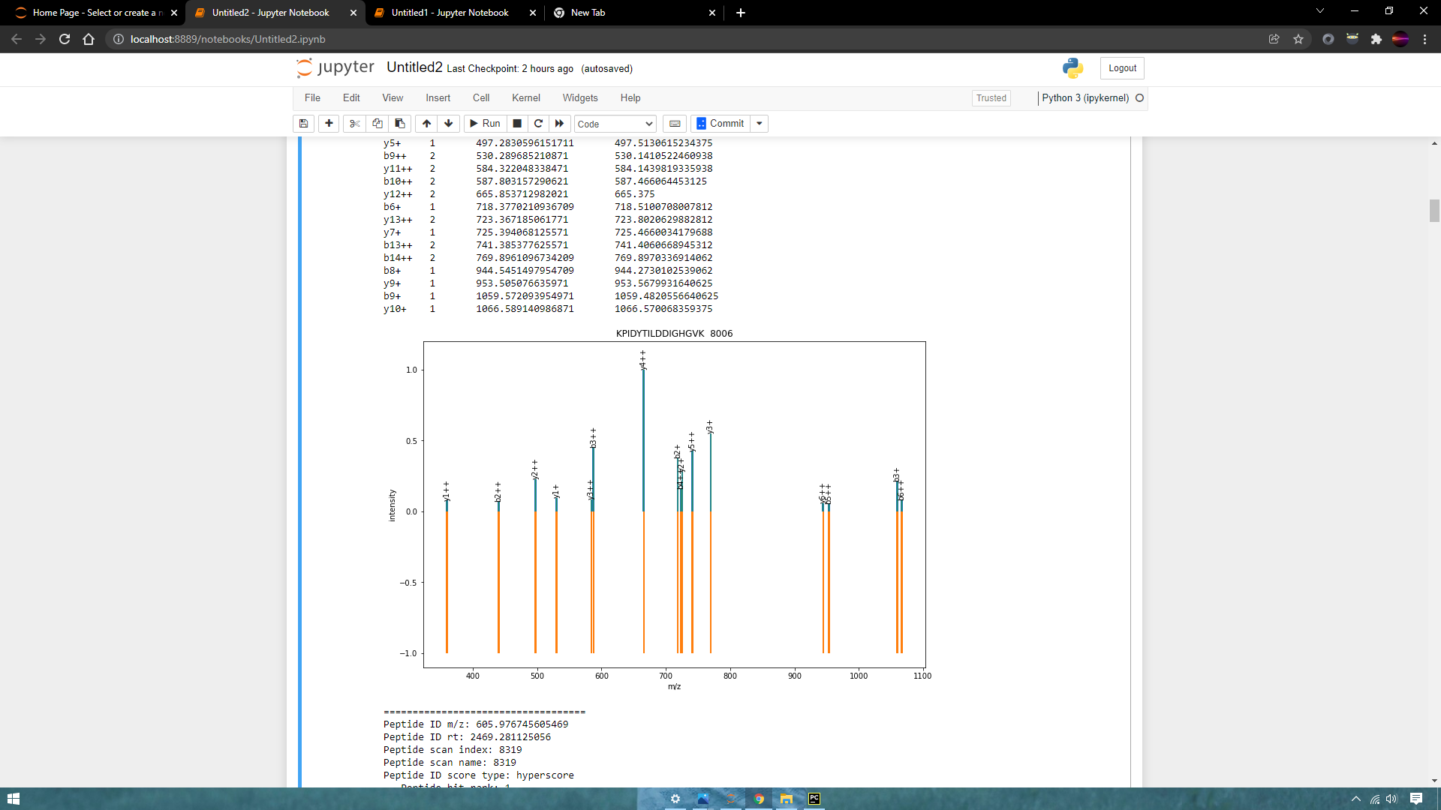
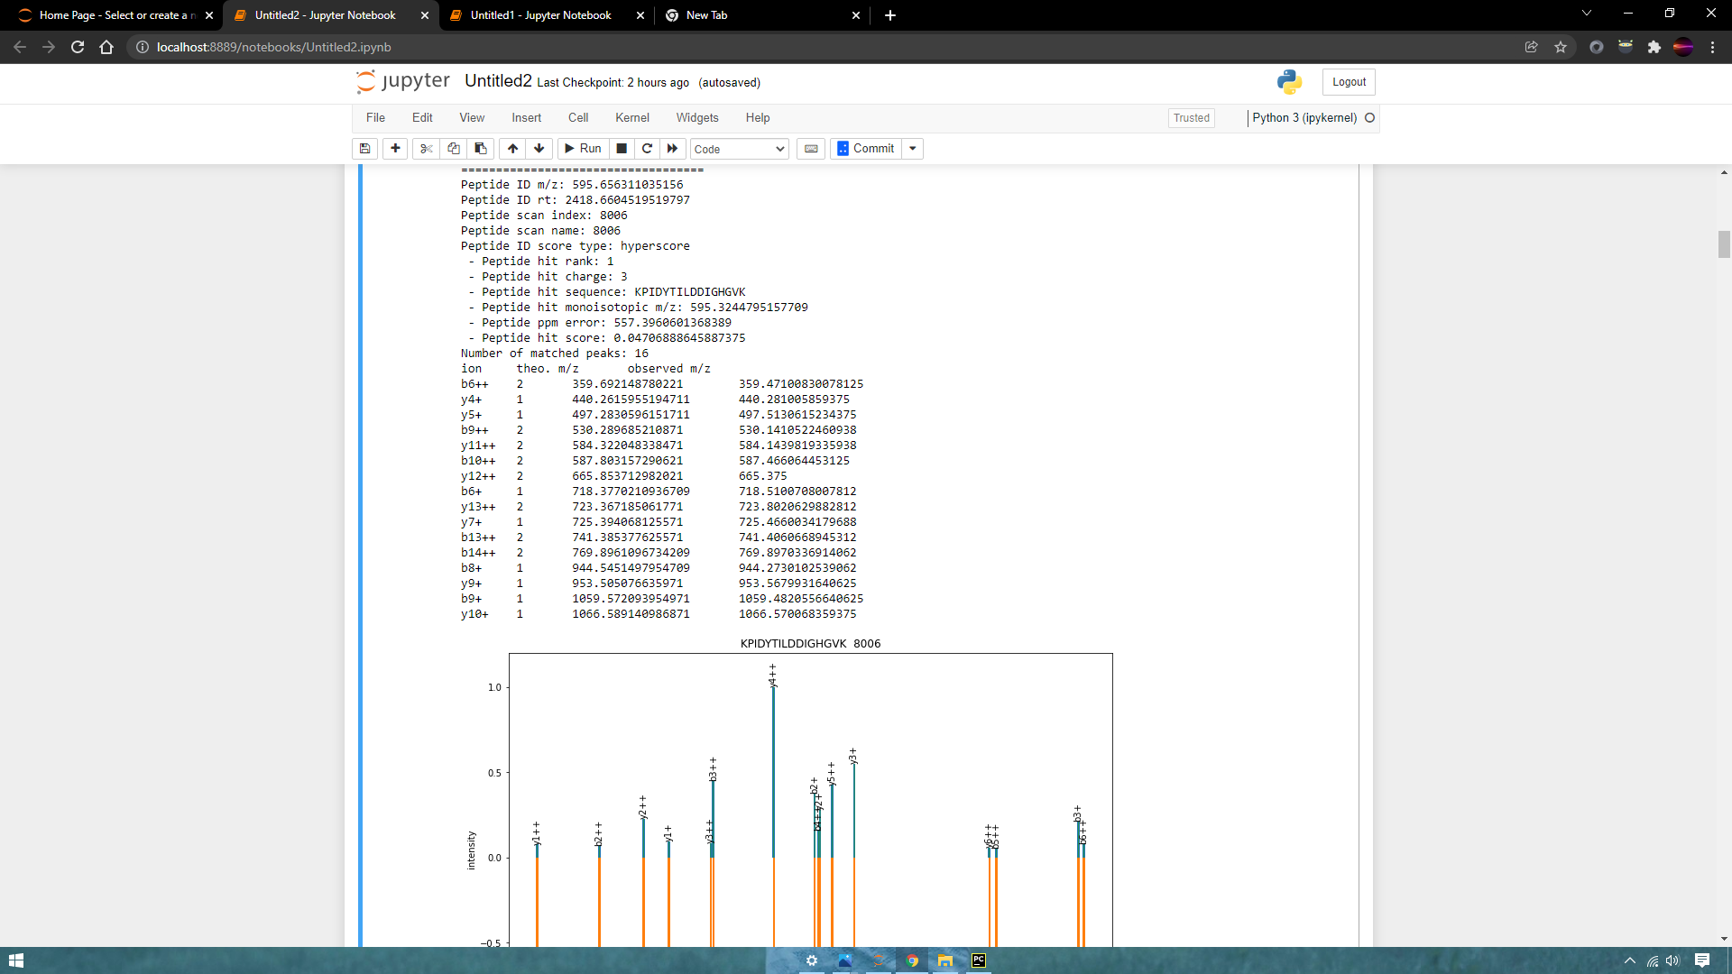
Retinoblastoma
File:DiGiannatale_F_0419_HSJD_RBVS_1_079_81.mzML

Slide 9
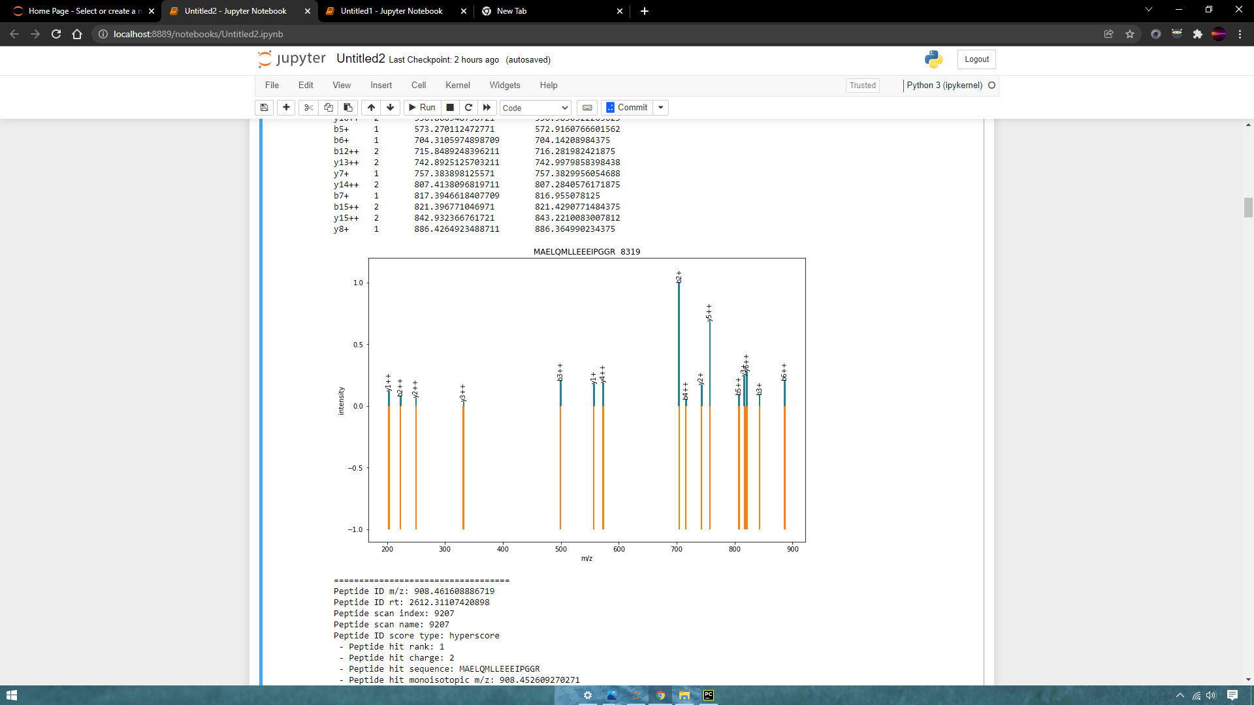
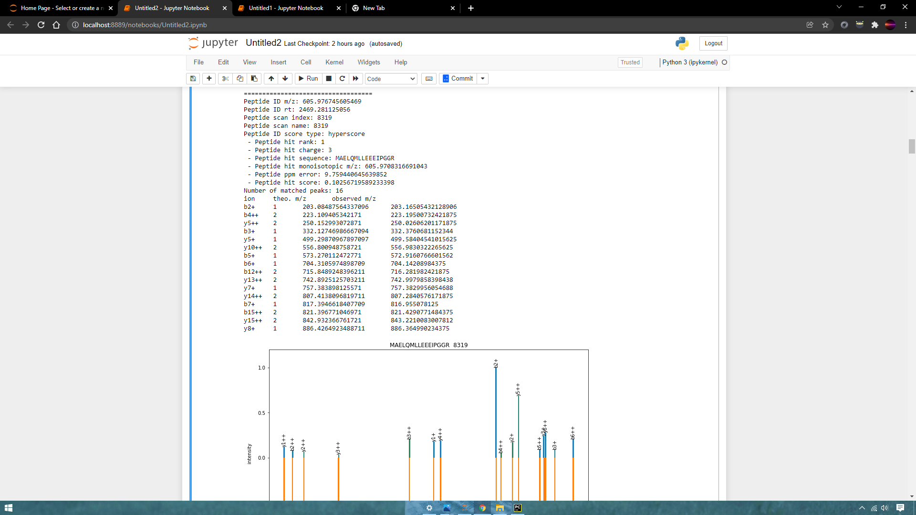

Slide 10
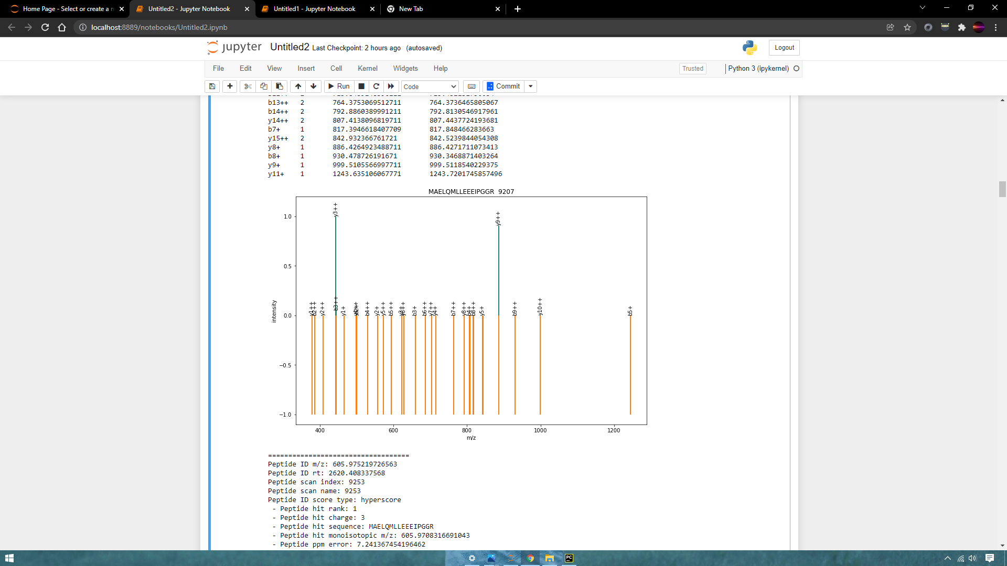
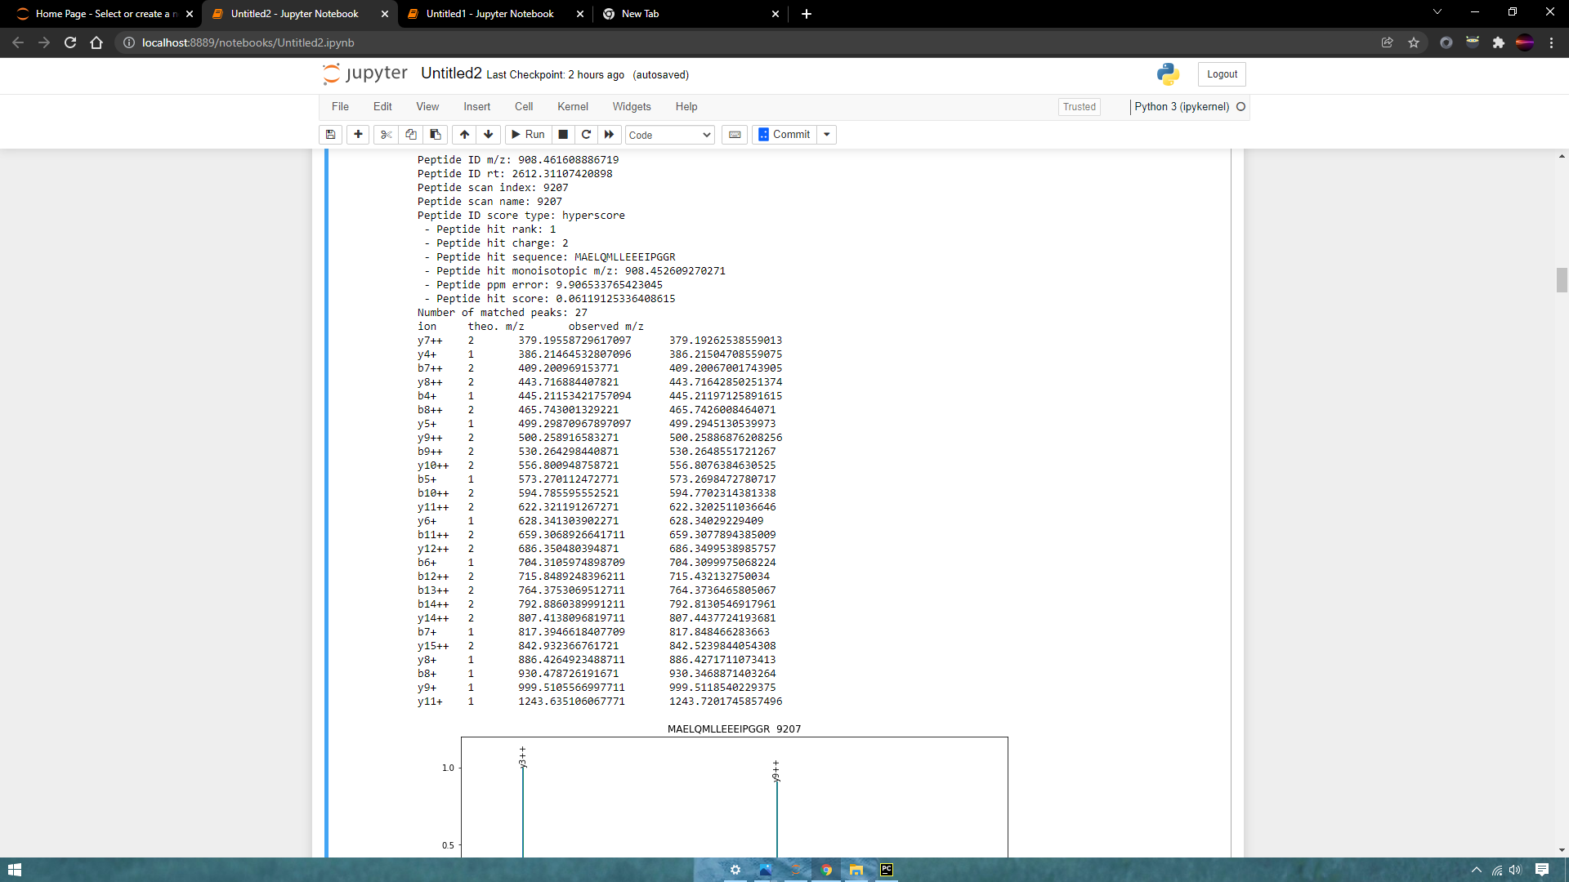

Slide 11
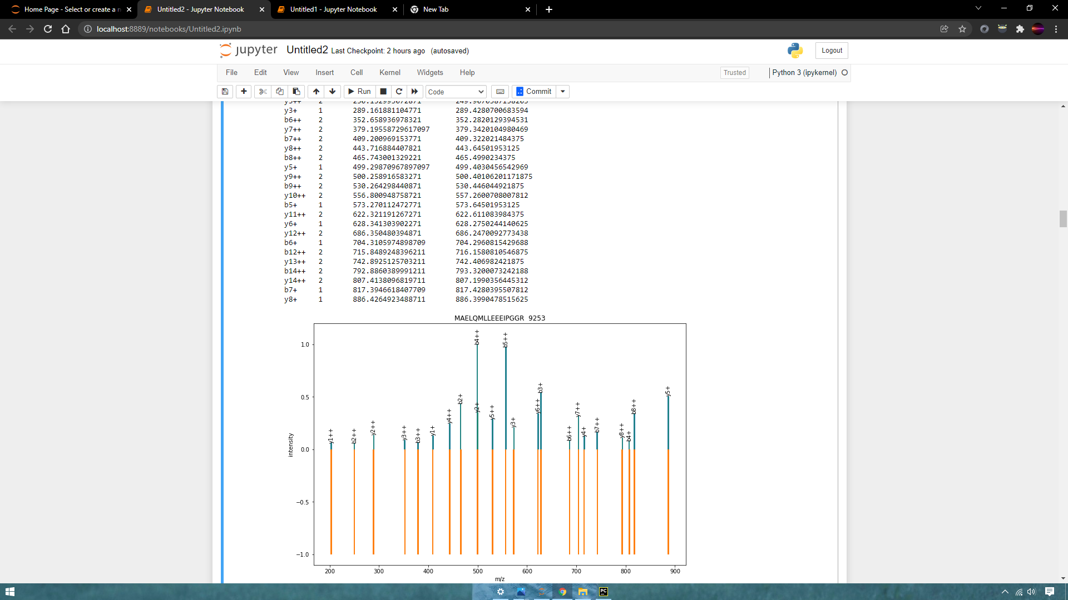
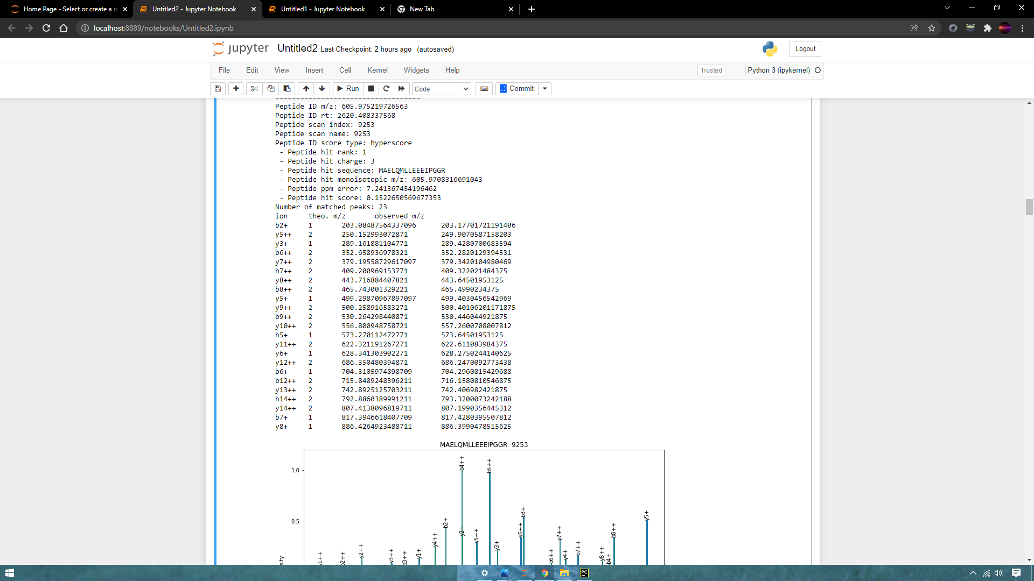

Slide 12
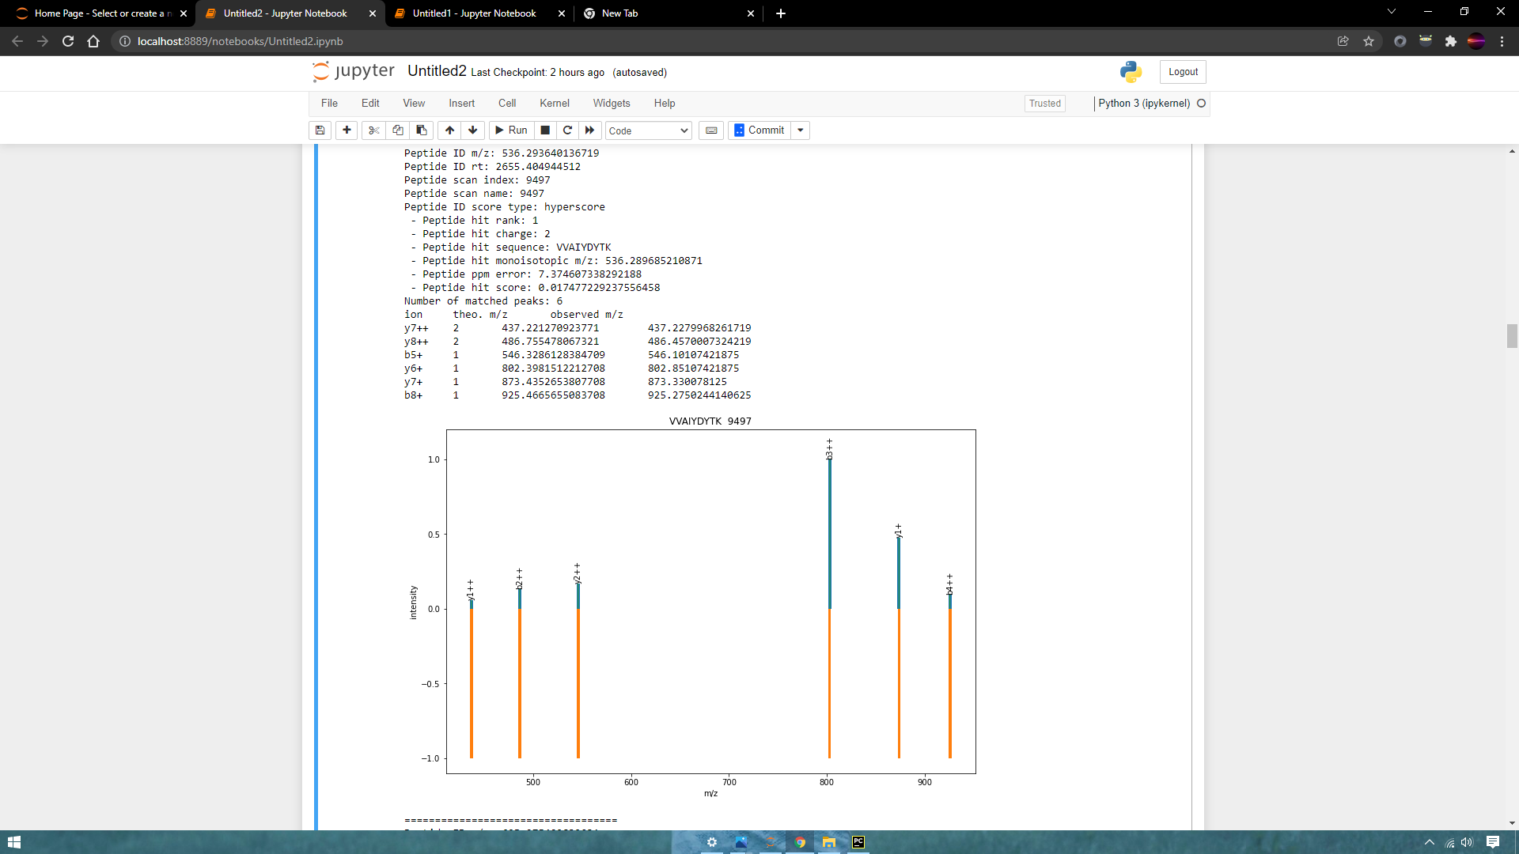

Slide 14
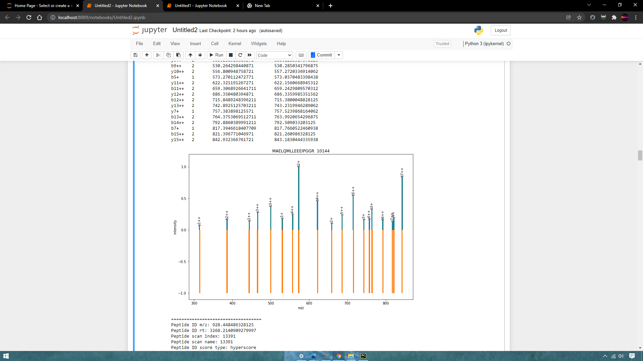
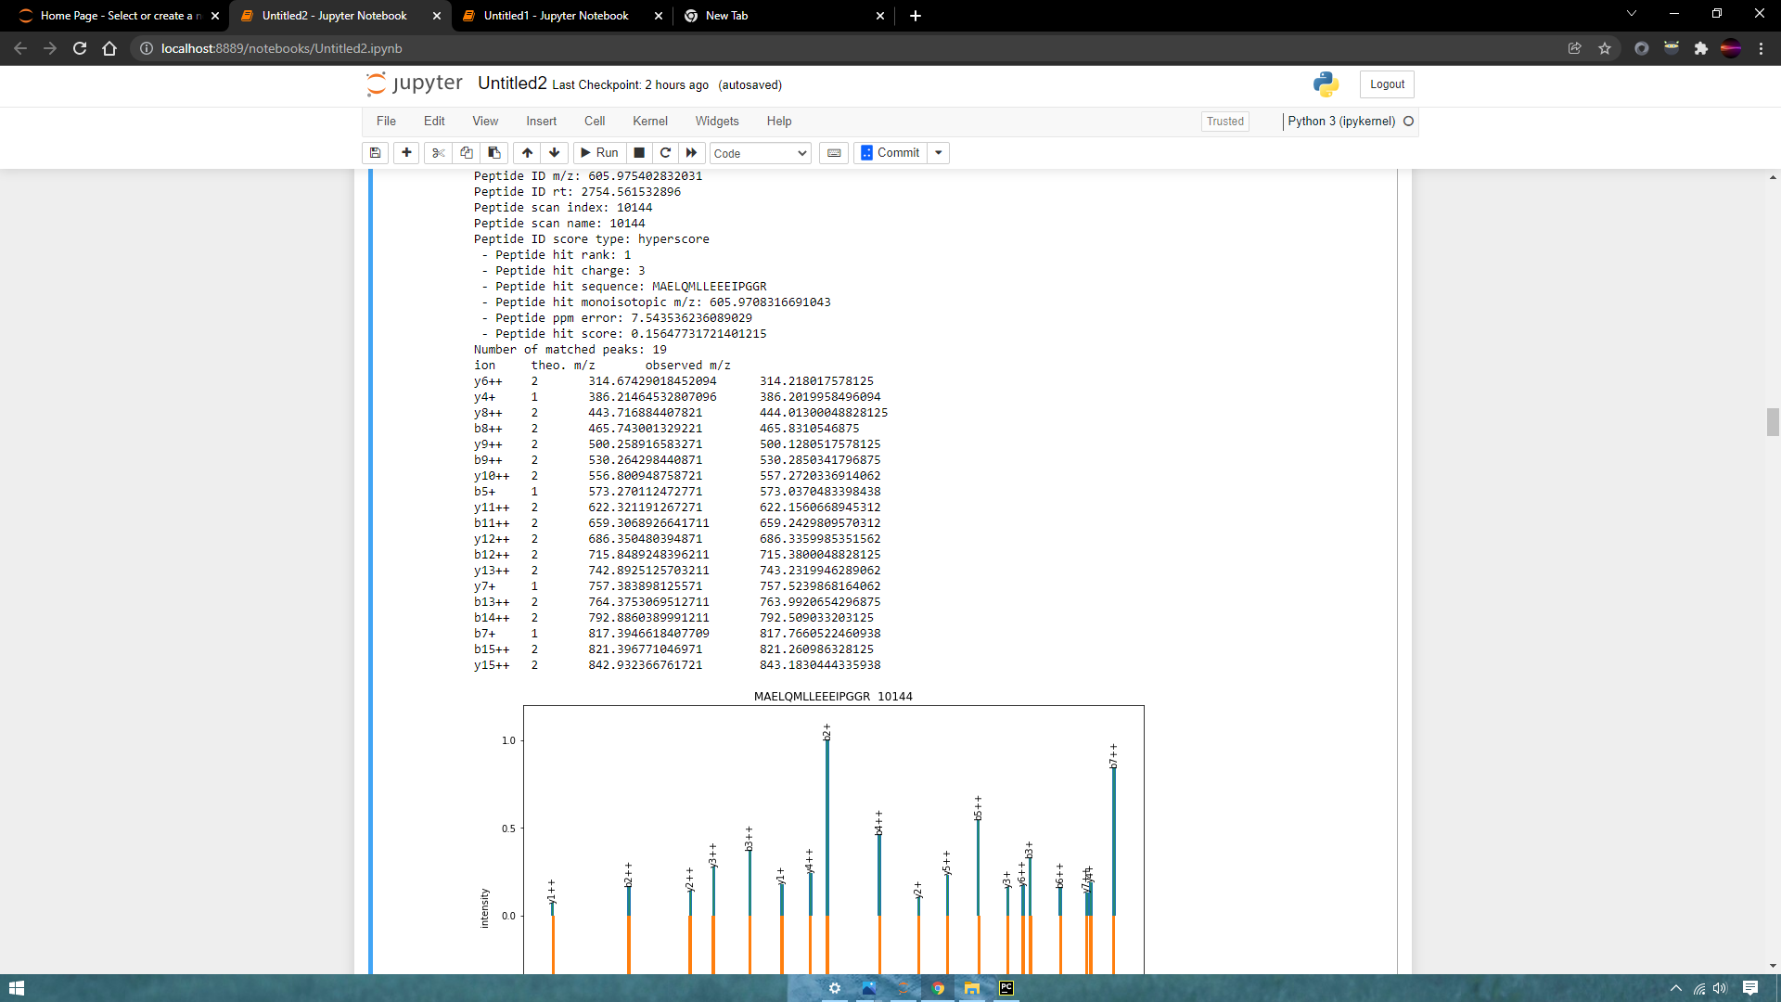
File: DiGiannatale_F_0419_HSJD_RBT_14_073_75.mzml

Slide 15
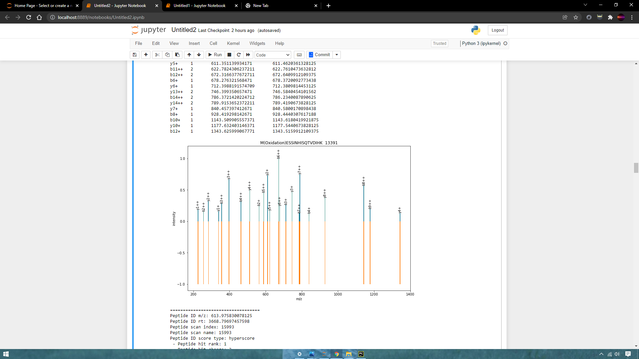
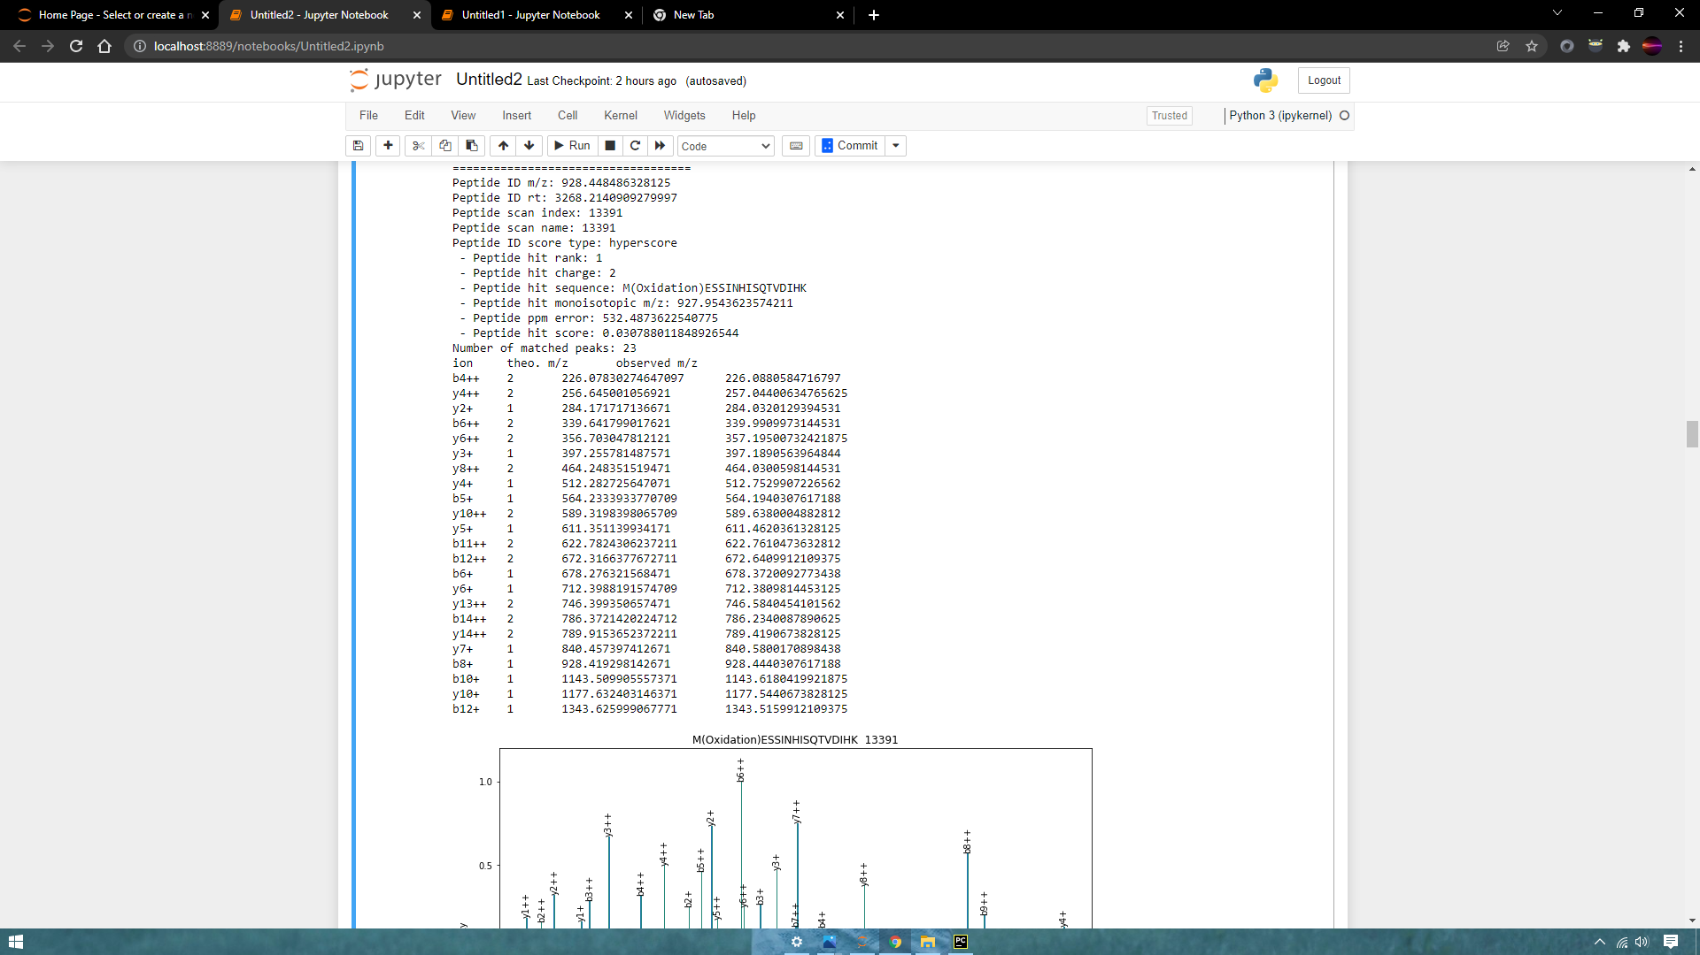

Slide 16
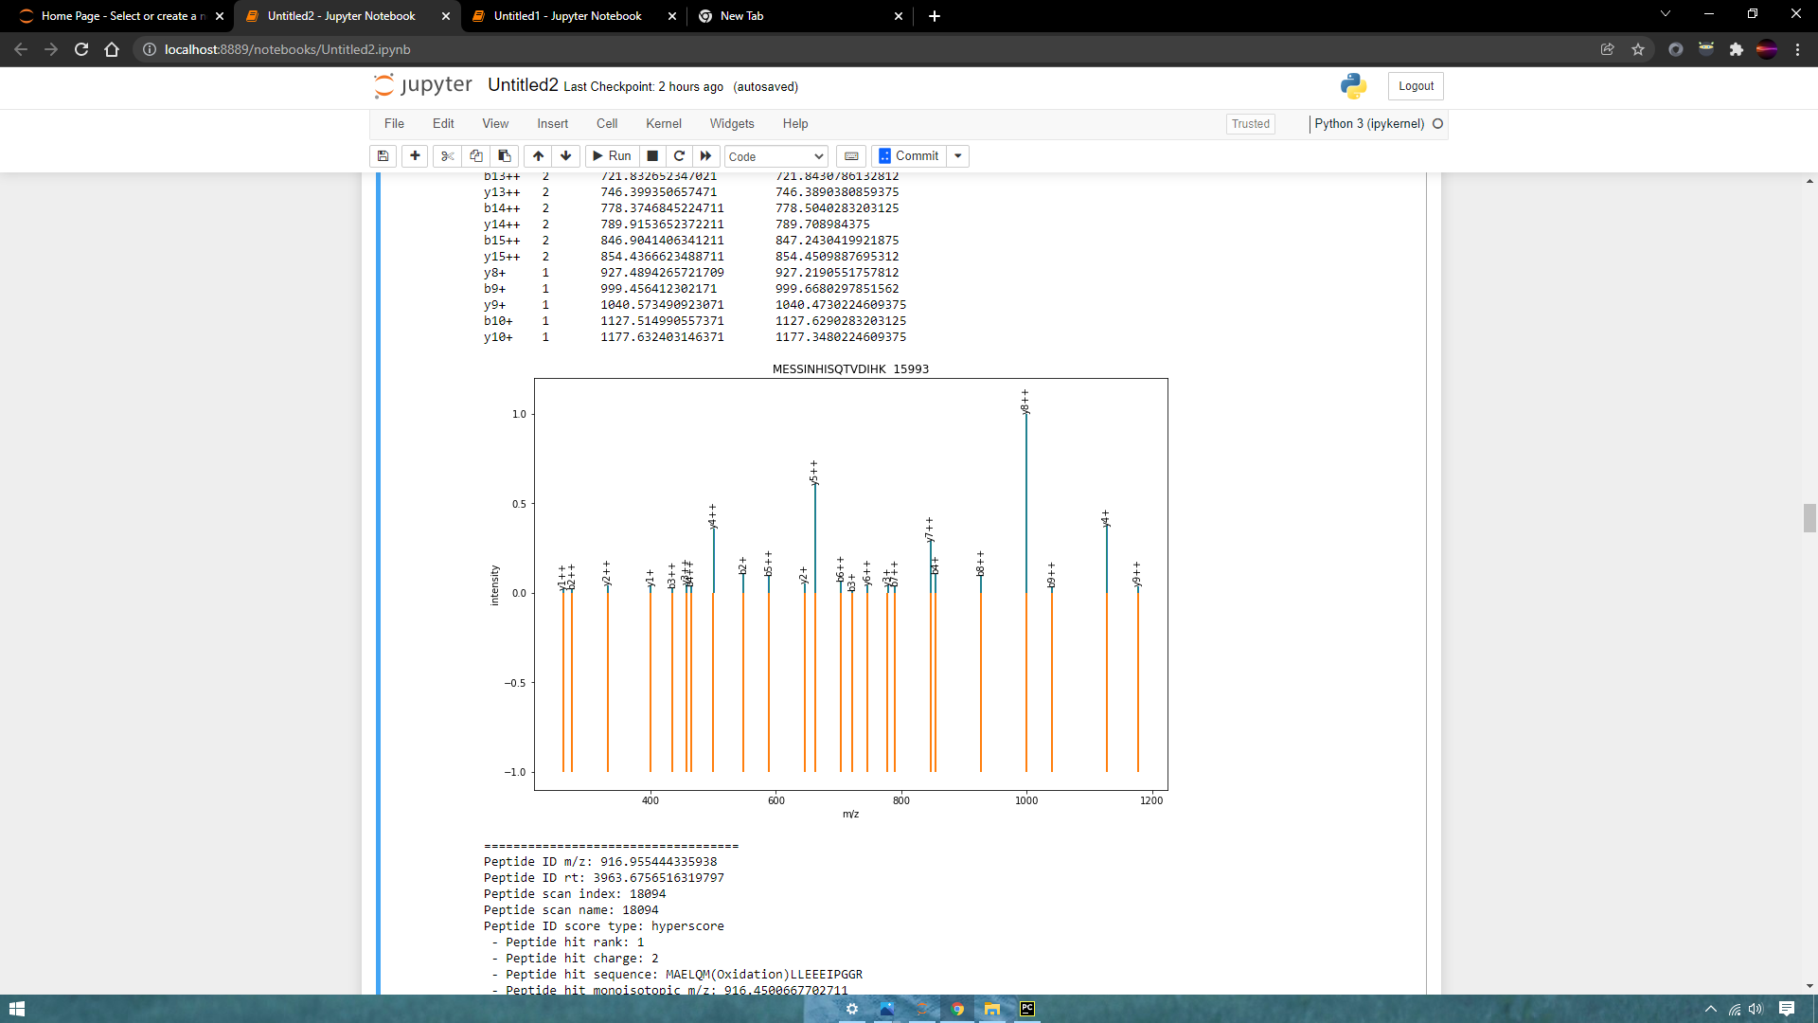
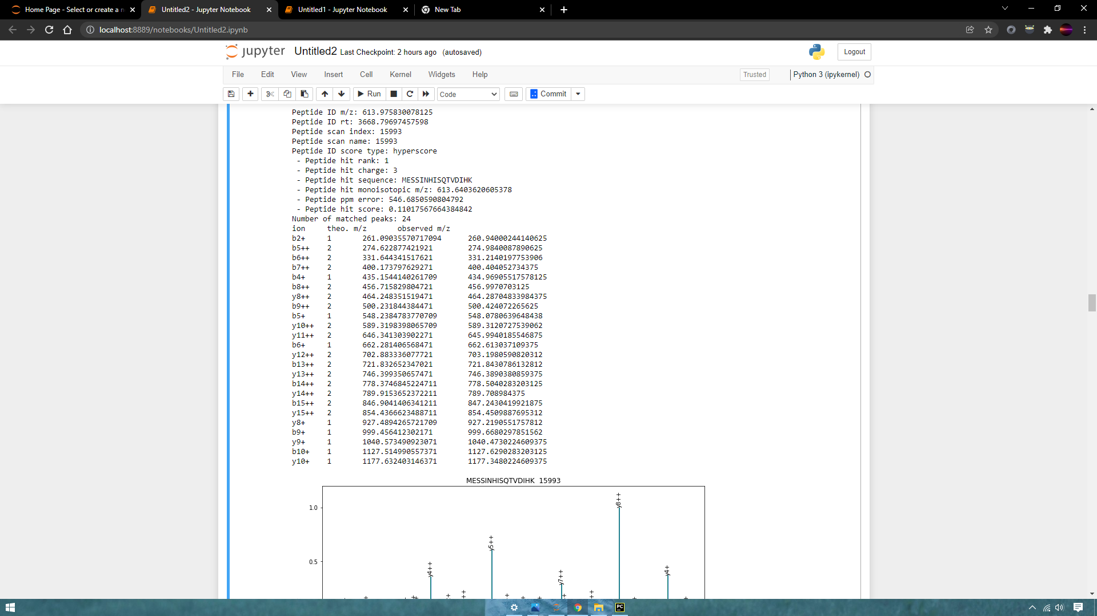

Slide 17
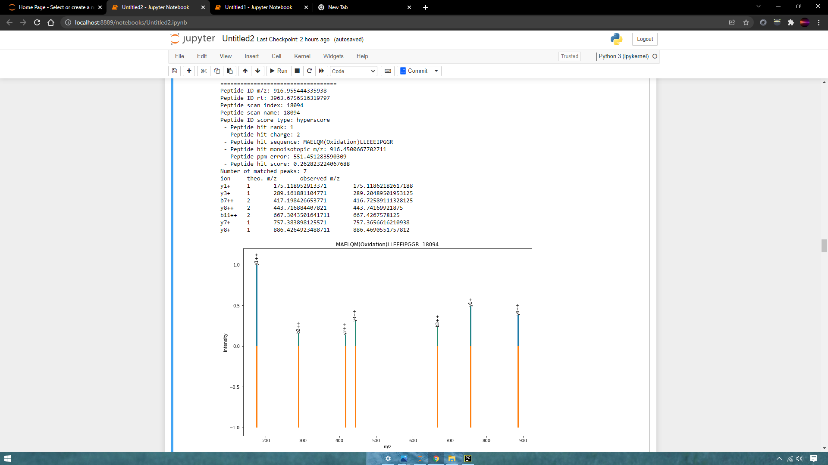

Slide 18
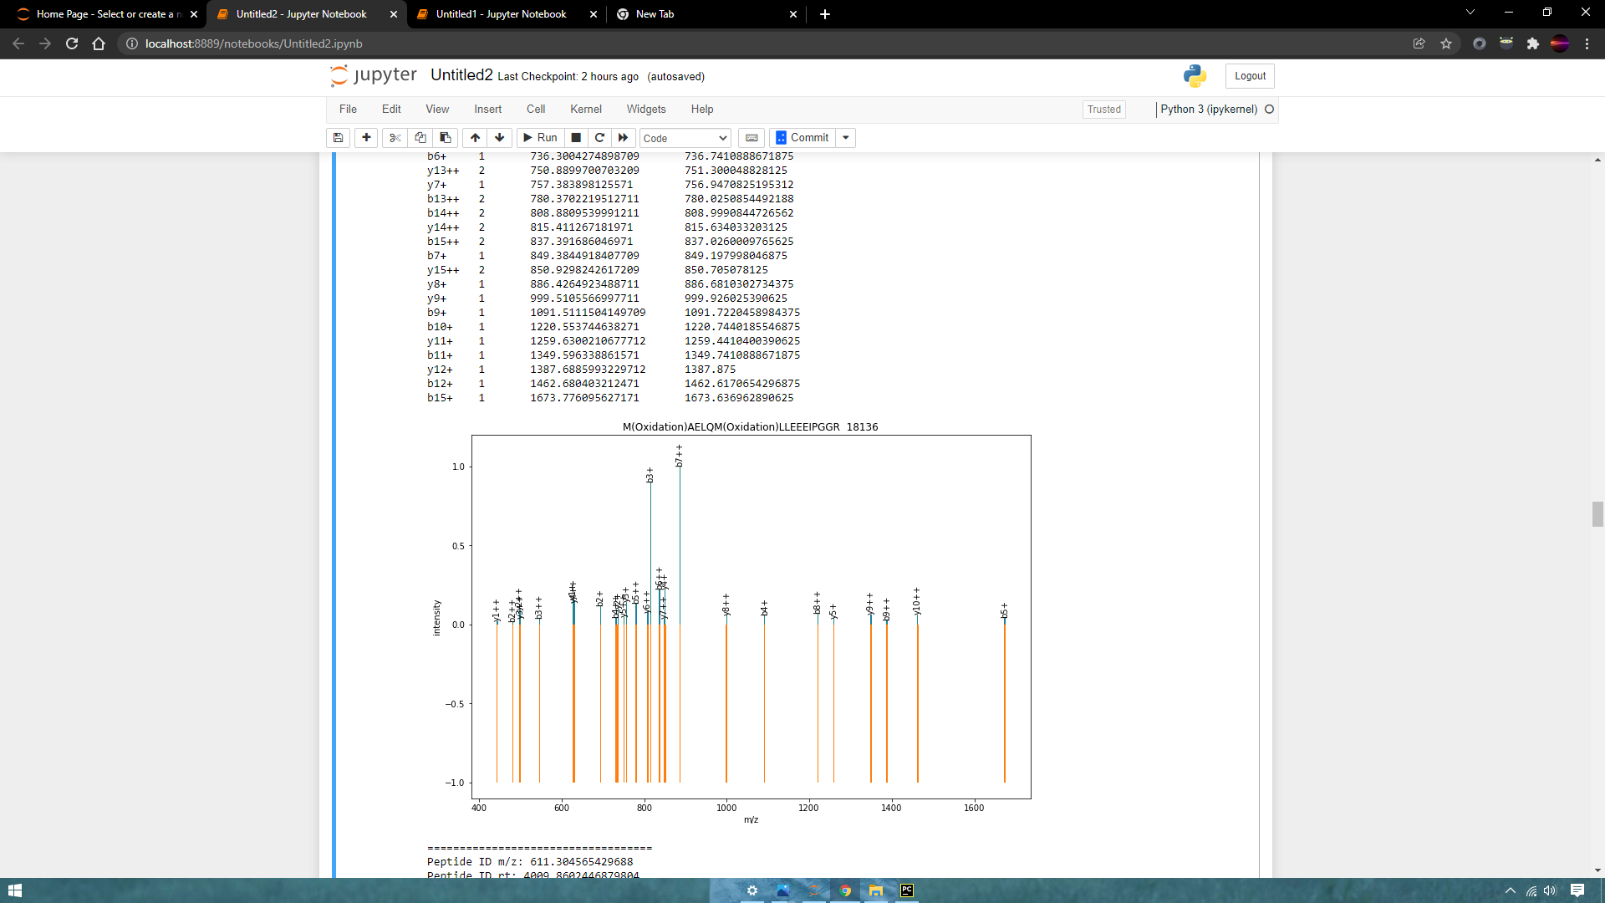
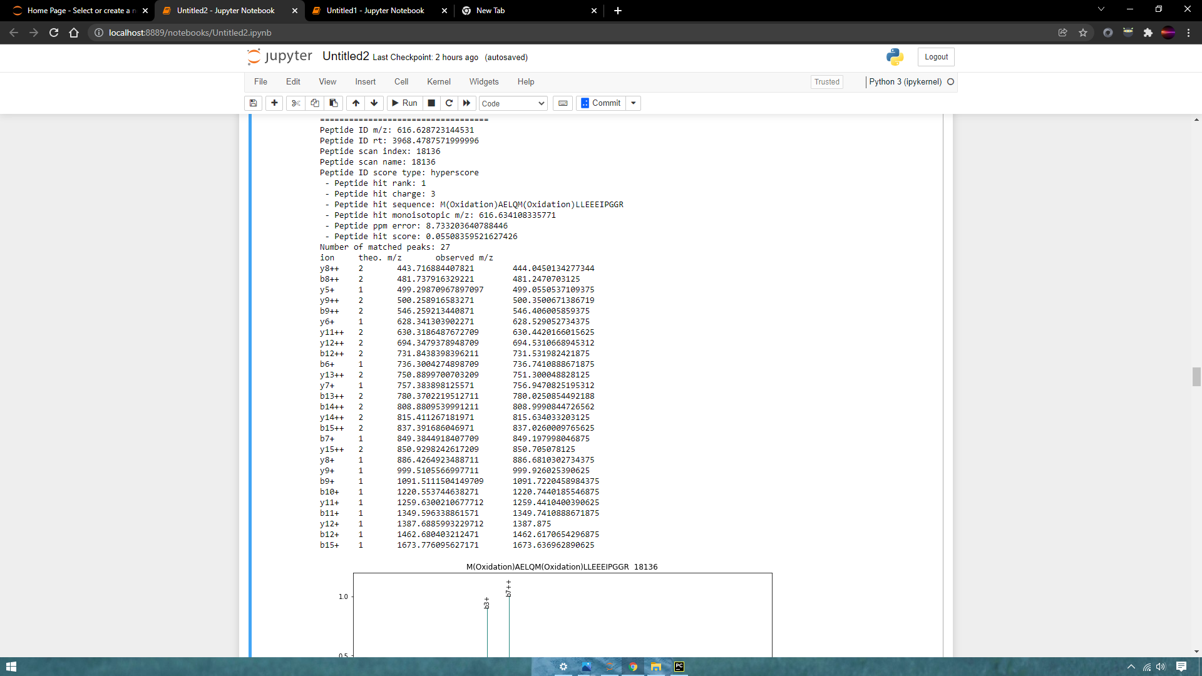

Slide 19
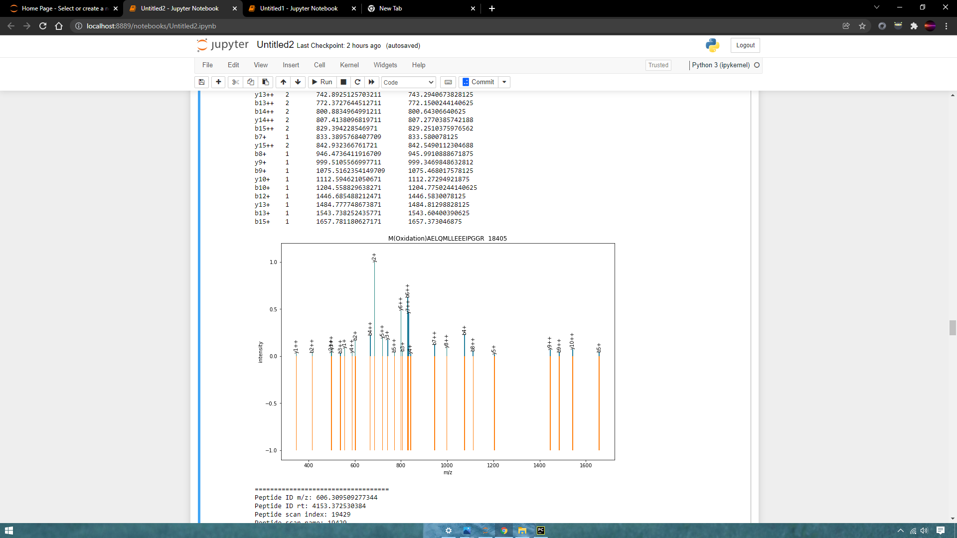
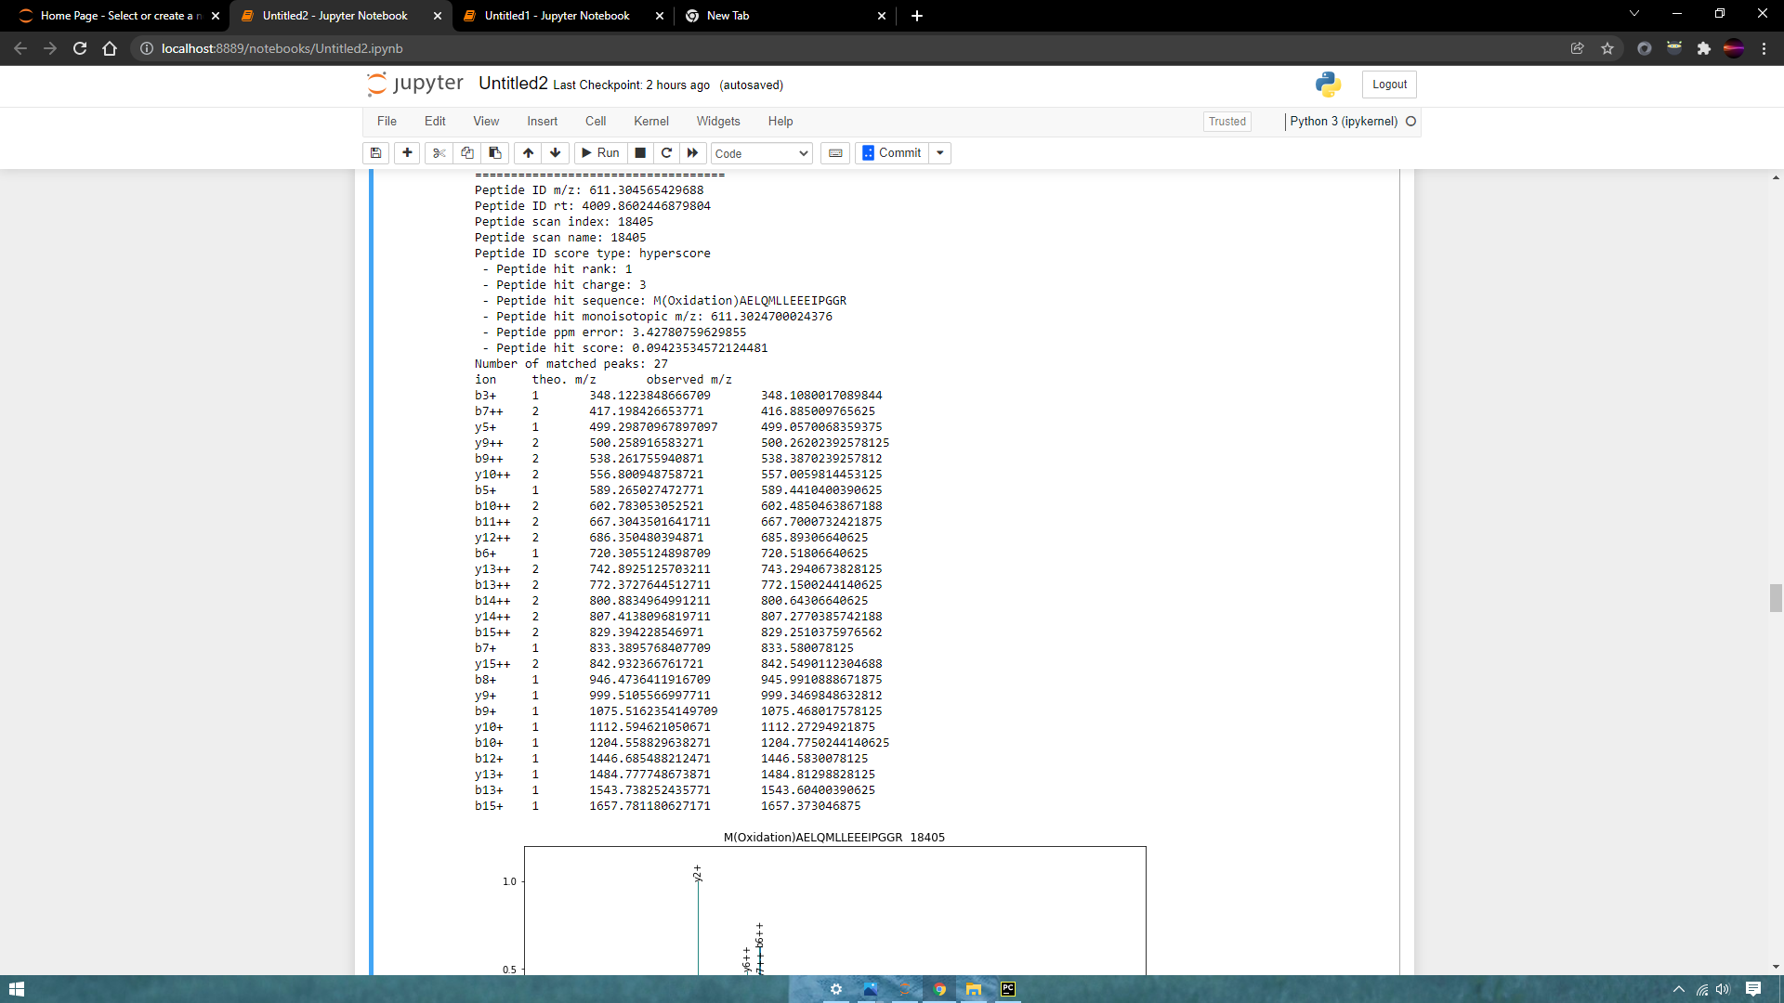

Slide 20
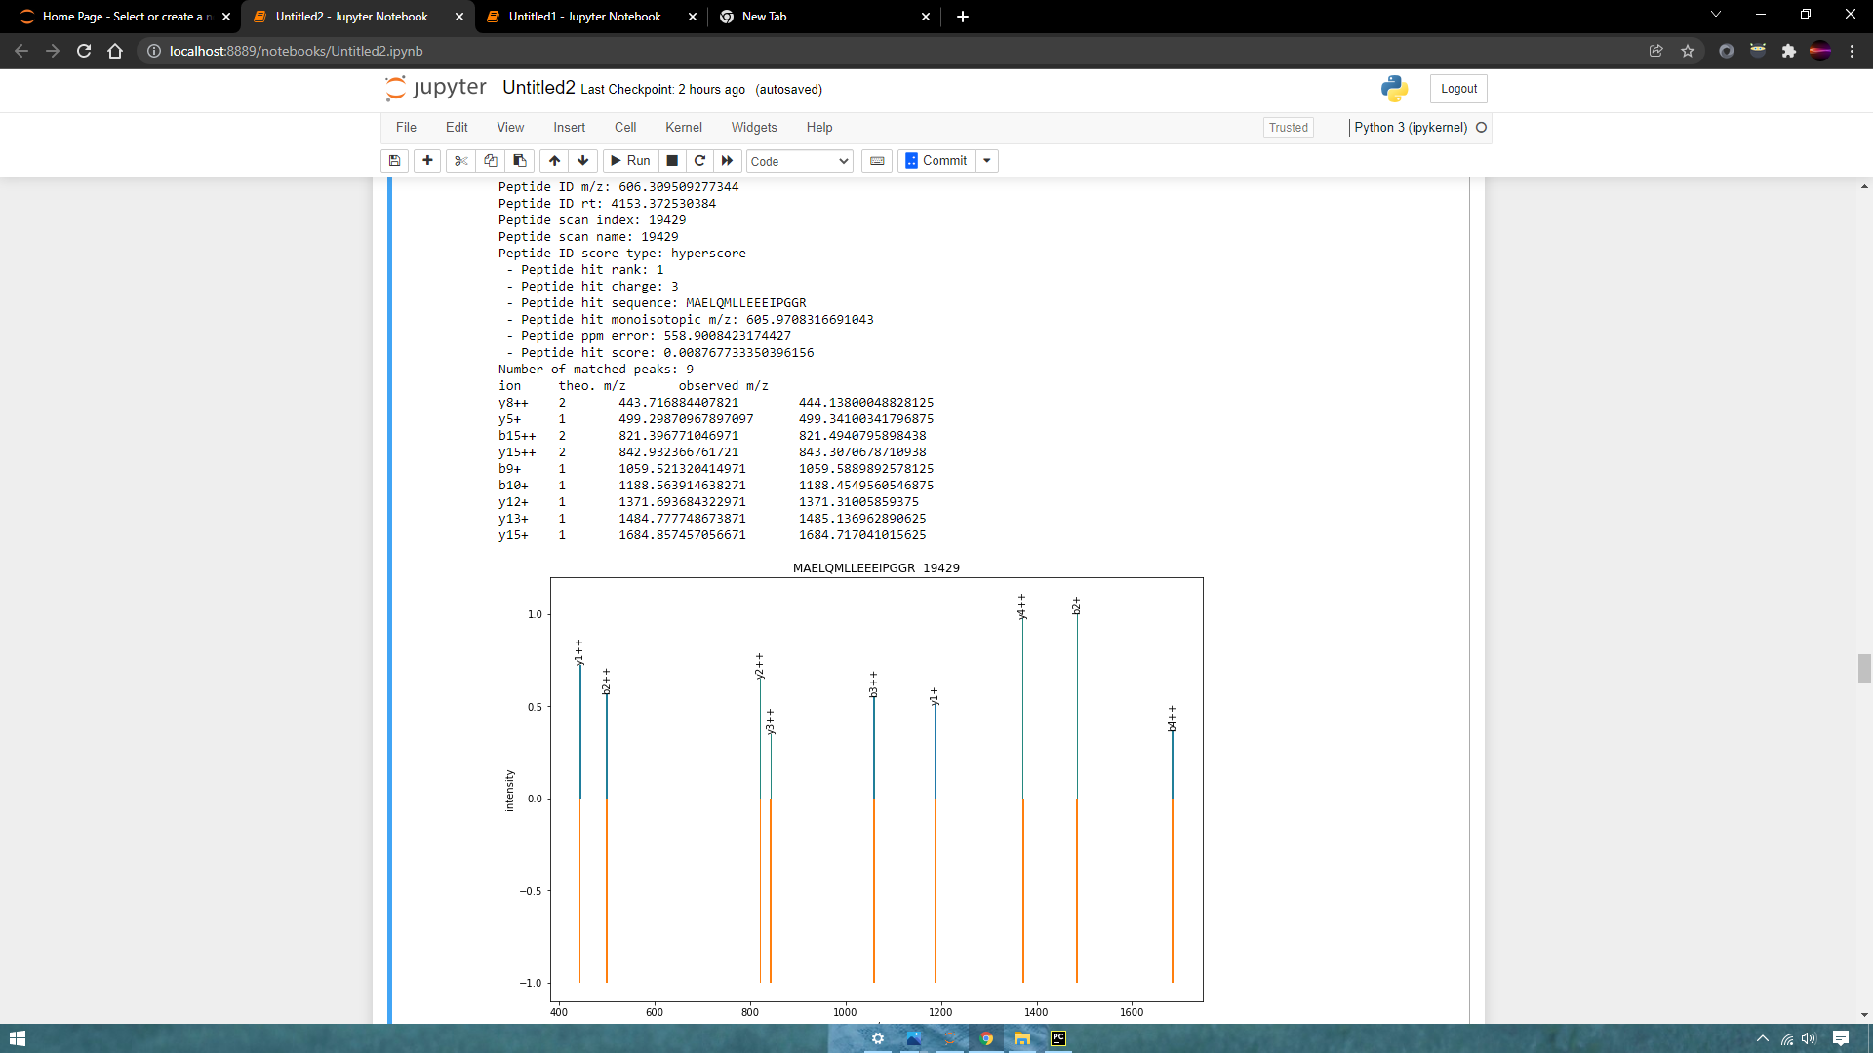

Slide 21
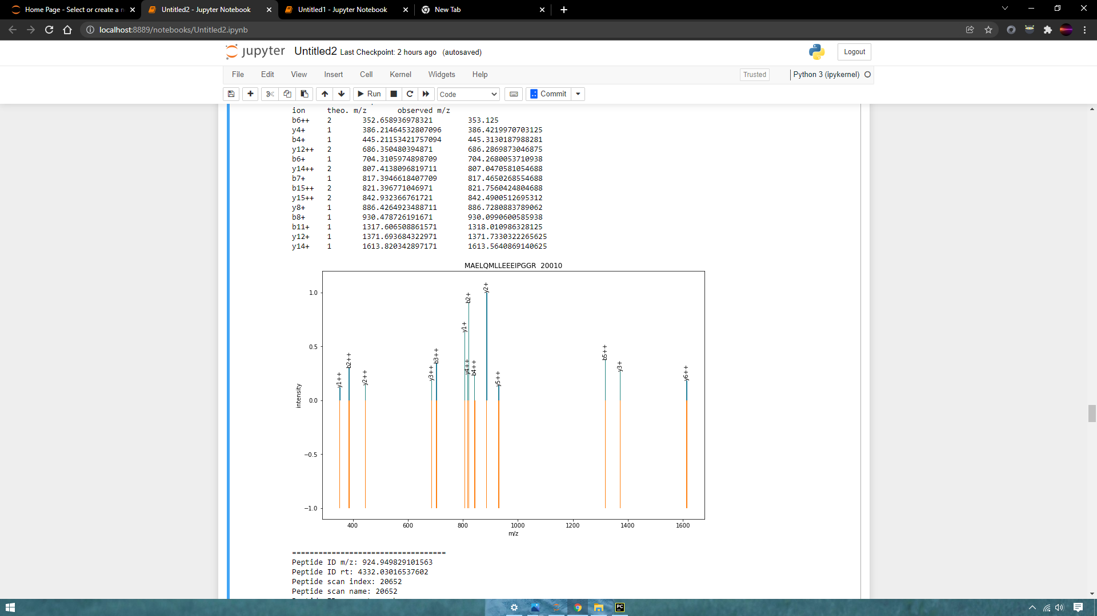
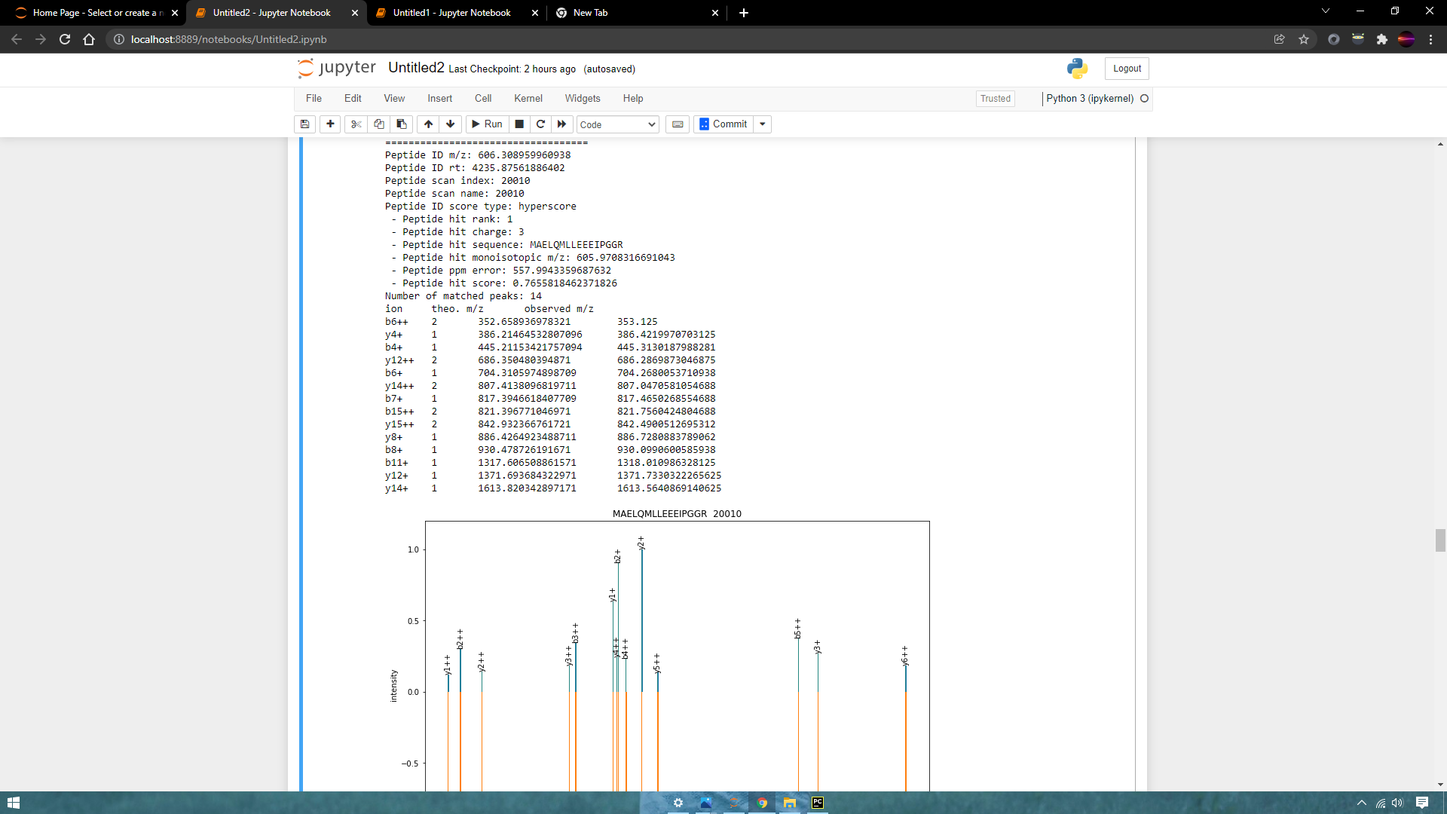
File: DiGiannatale_F_0419_HSJD_RBT_5_061_63.mzml

Slide 22
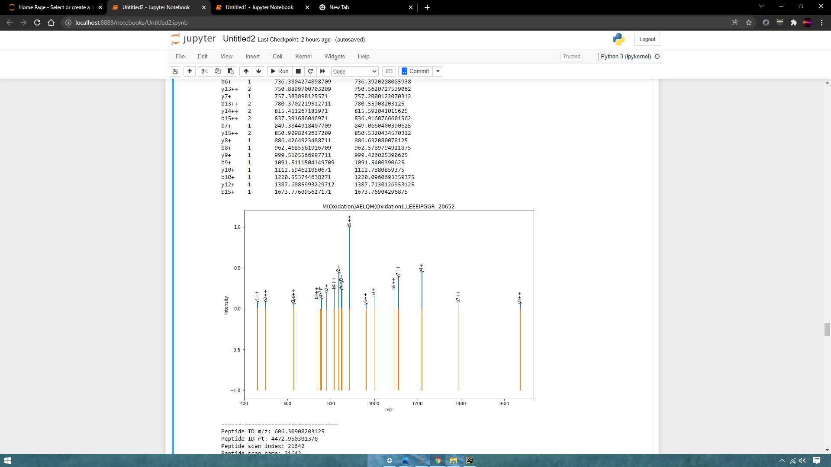
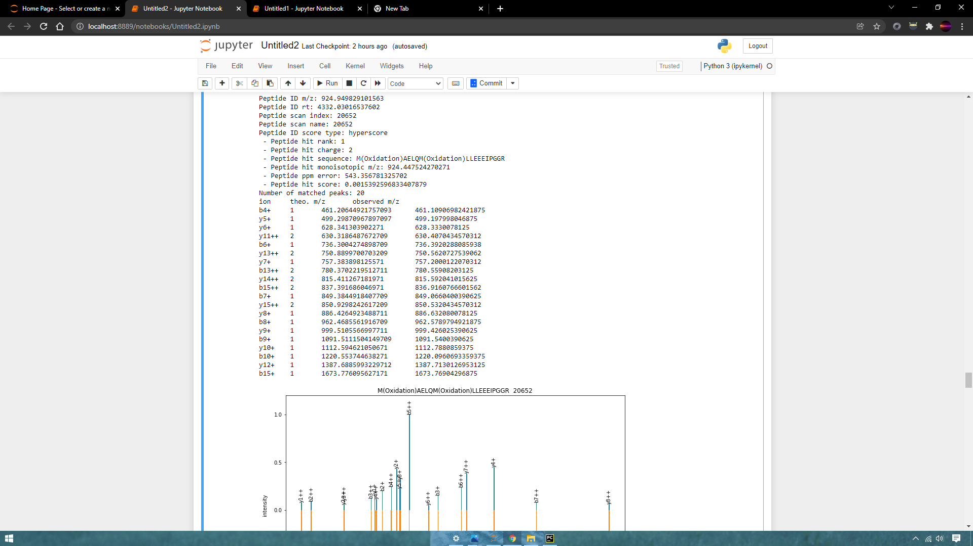

Slide 23
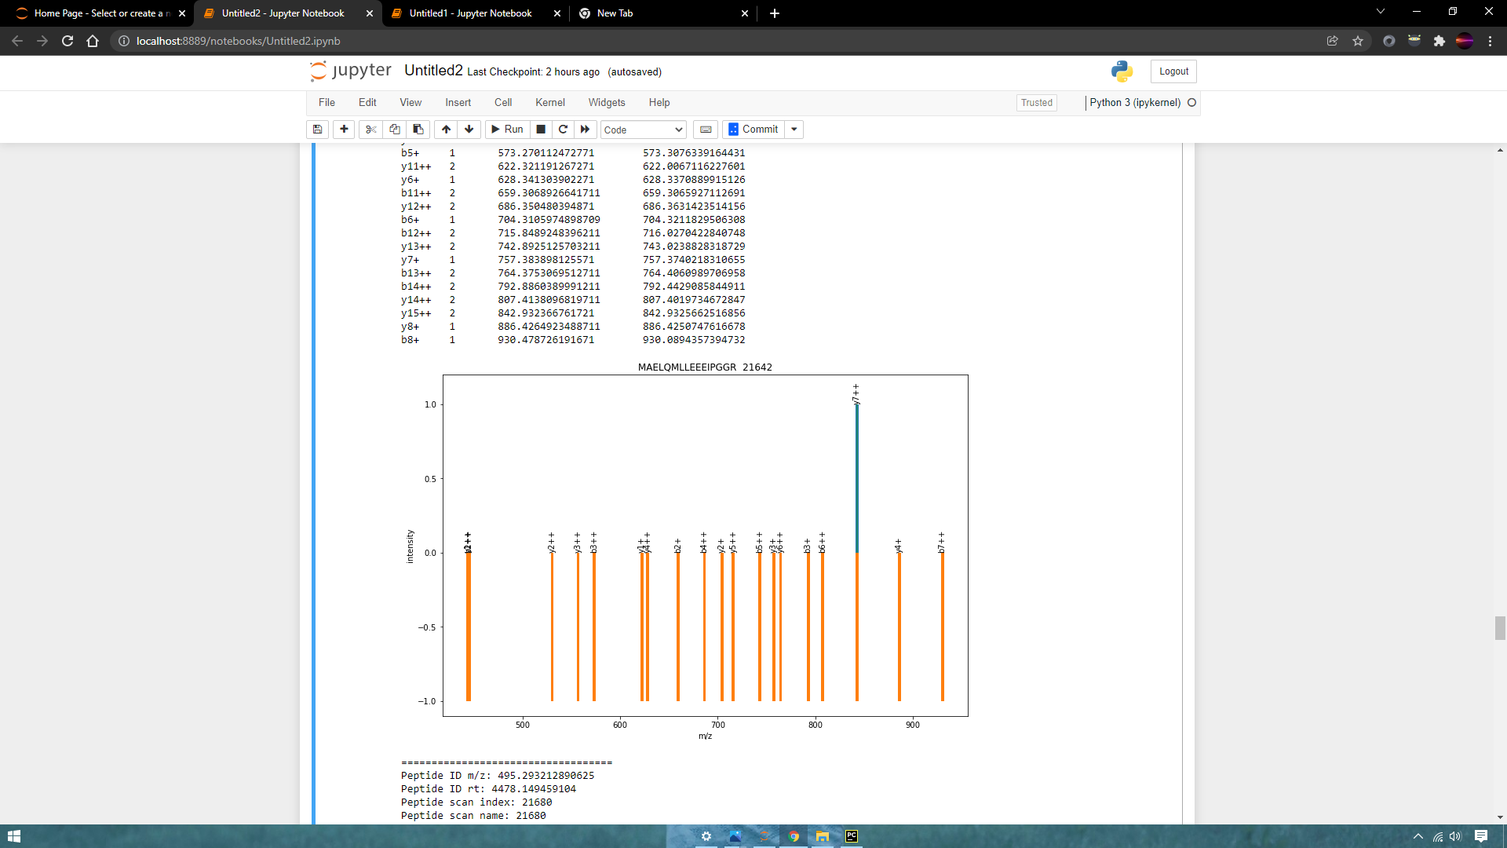
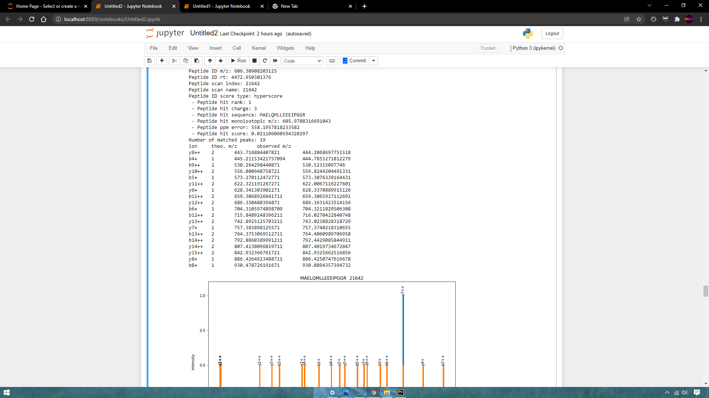

Slide 24
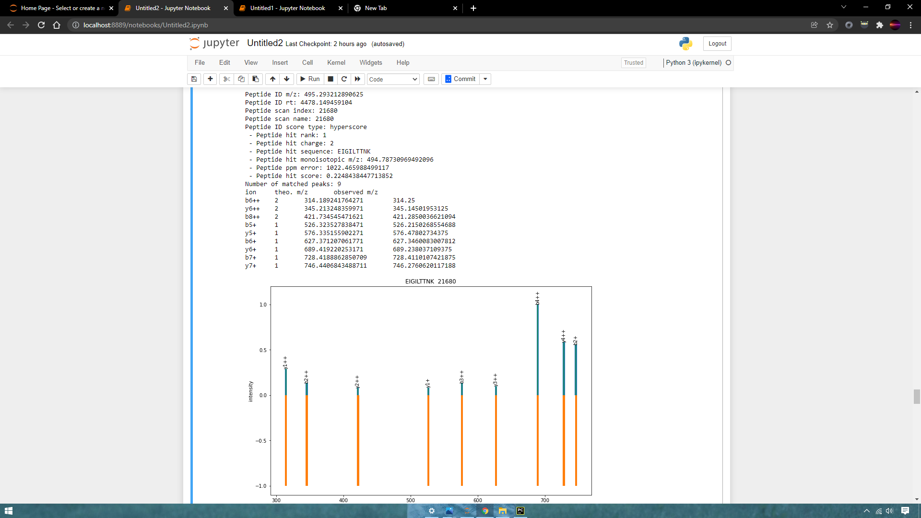

Slide 25
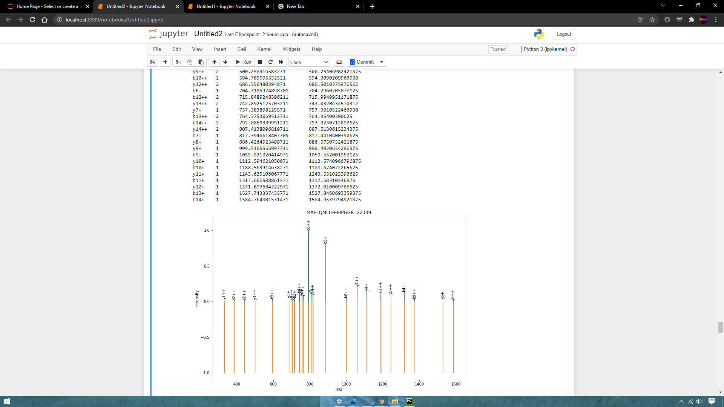


Slide 26
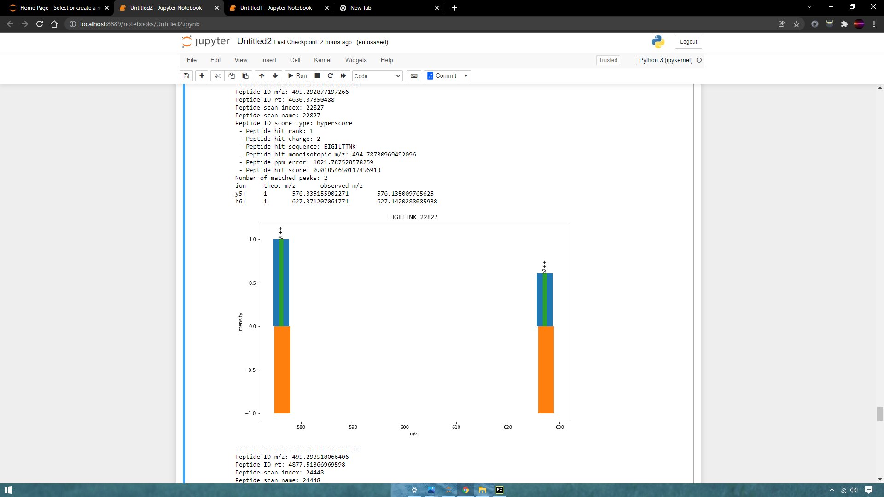

Slide 27
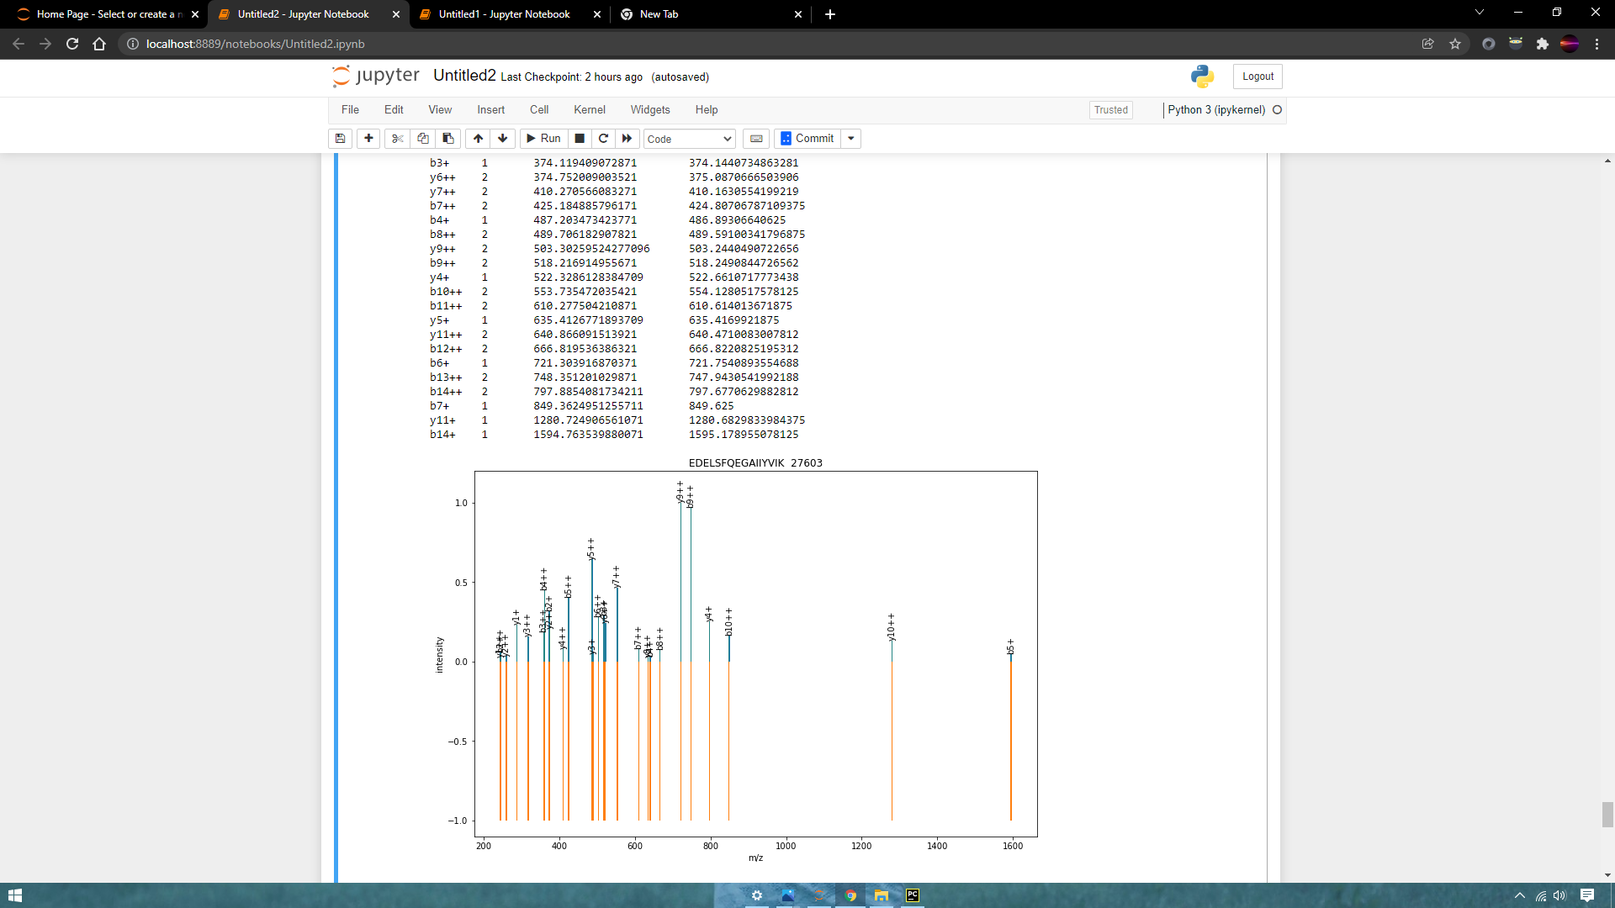
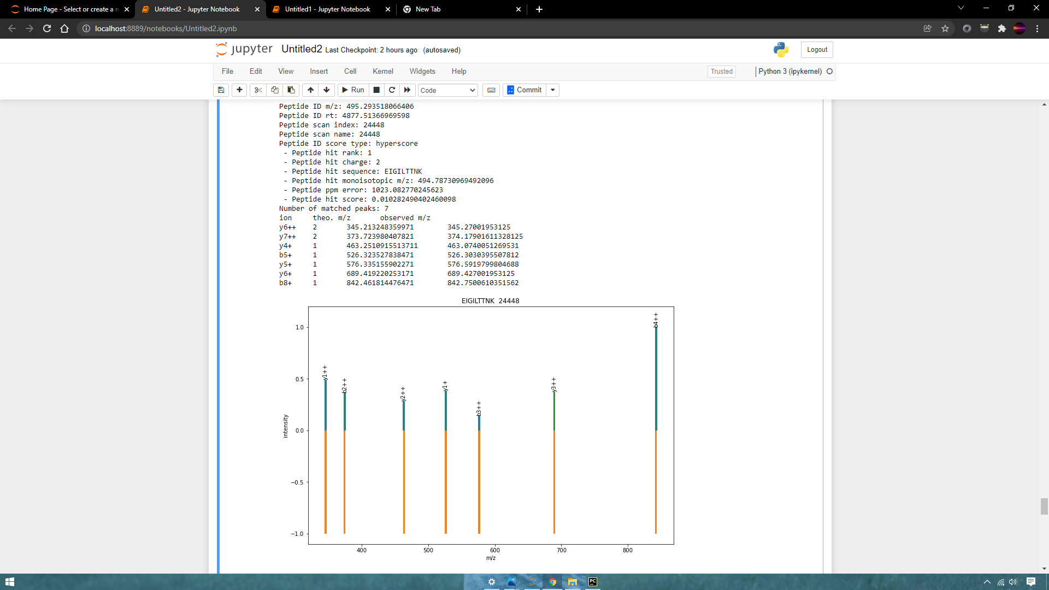

Slide 28
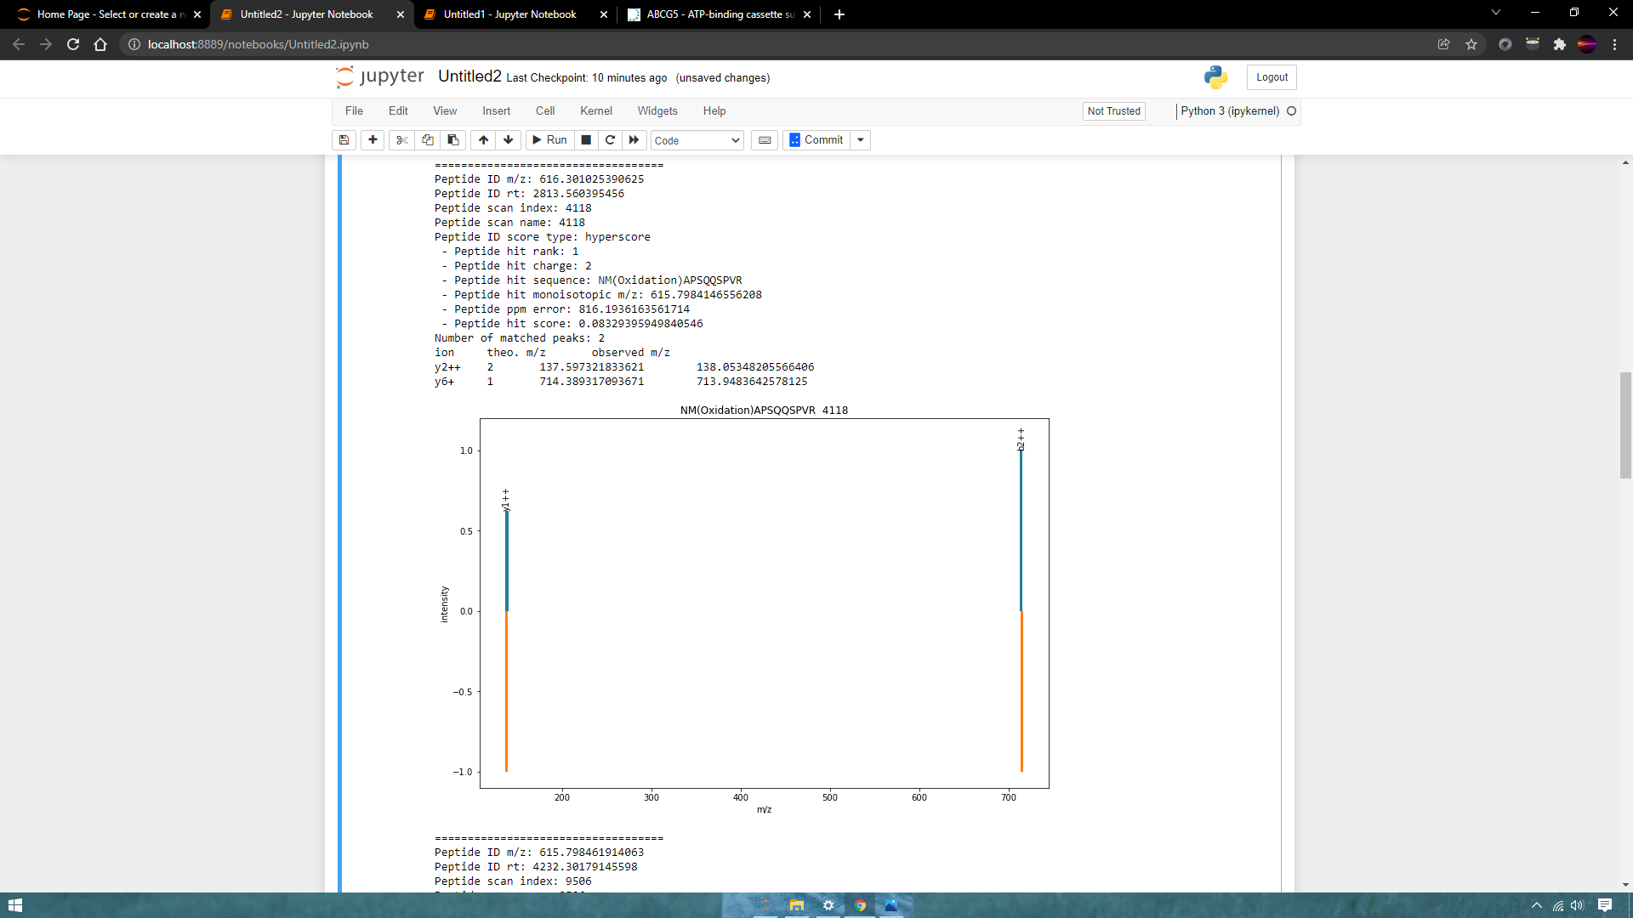
File:PRB_Phospho_8

Slide 29
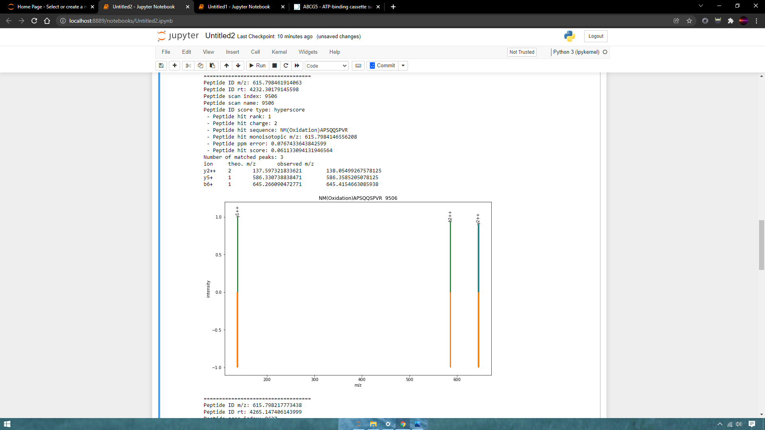

Slide 30
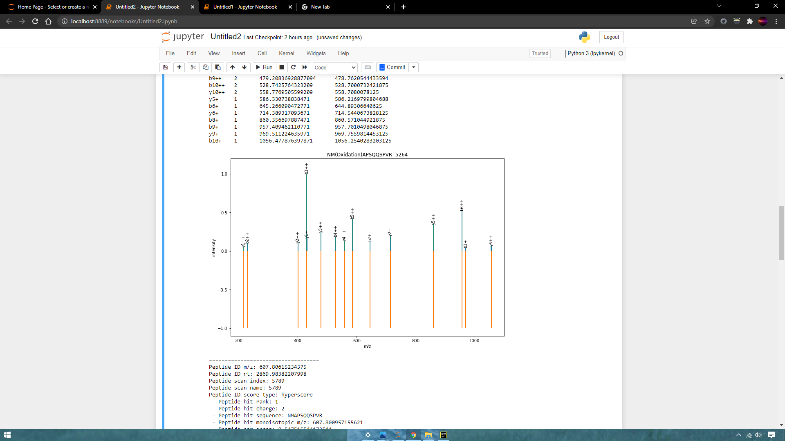
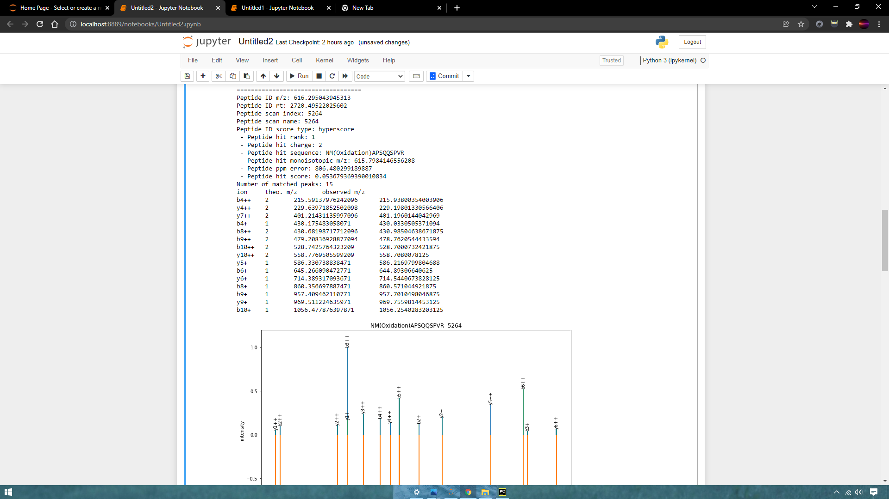

Slide 31
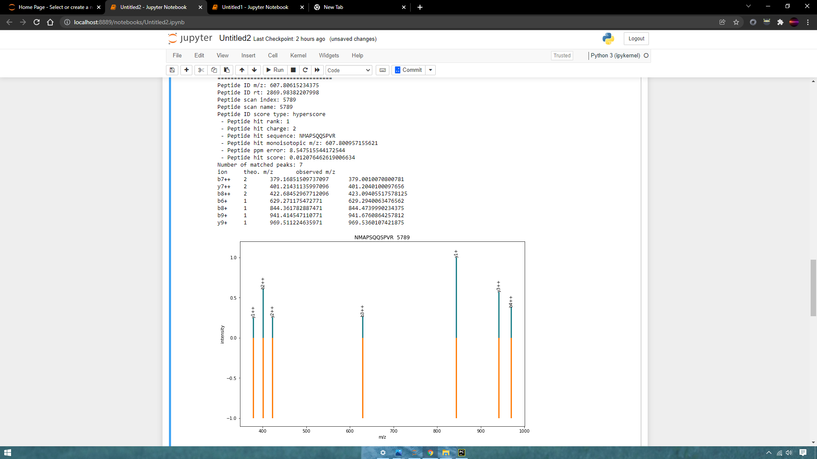

Slide 32
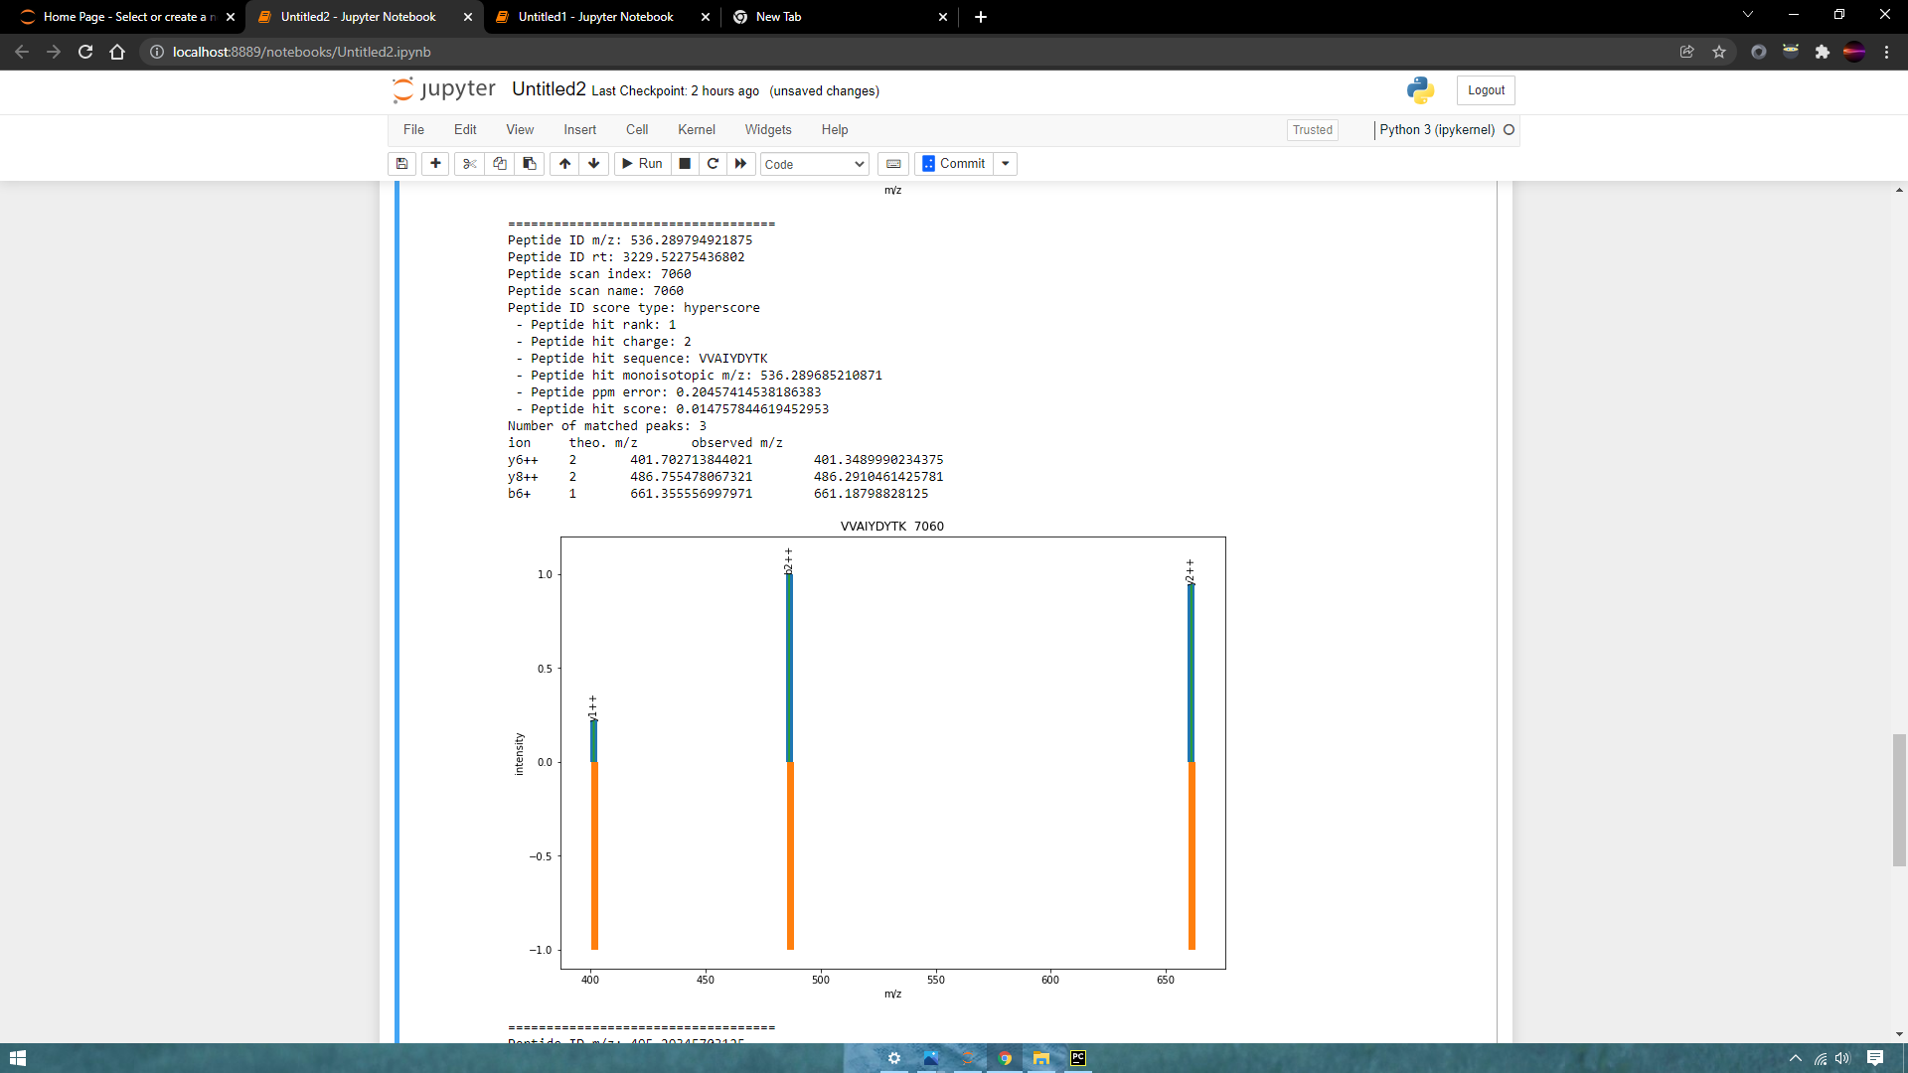

Slide 33
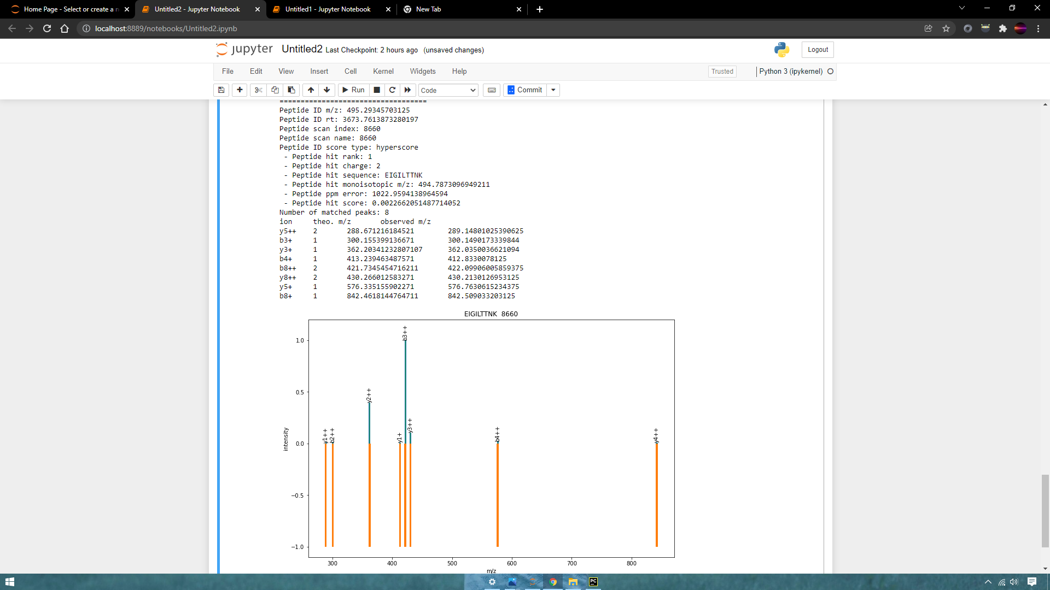

Slide 34
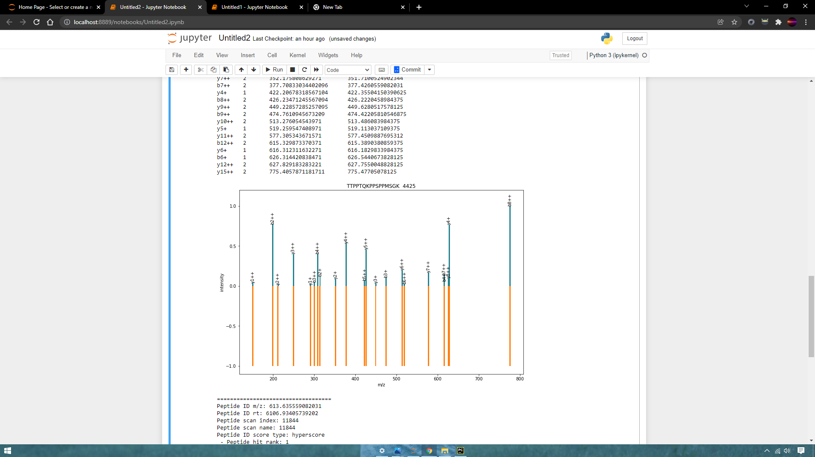

Lung
File:200309LU1_Li_NGL_NB_4_16_FS_70

Slide 35
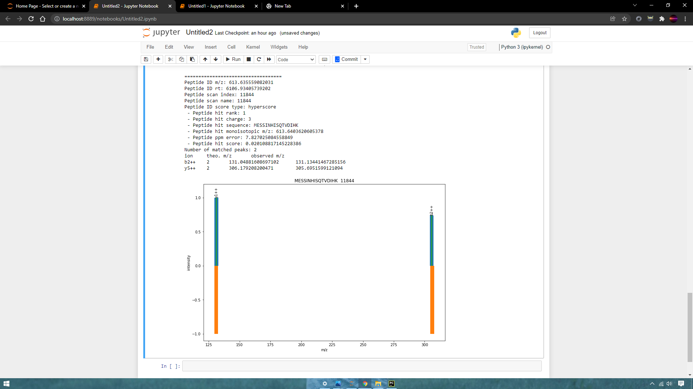

Slide 36
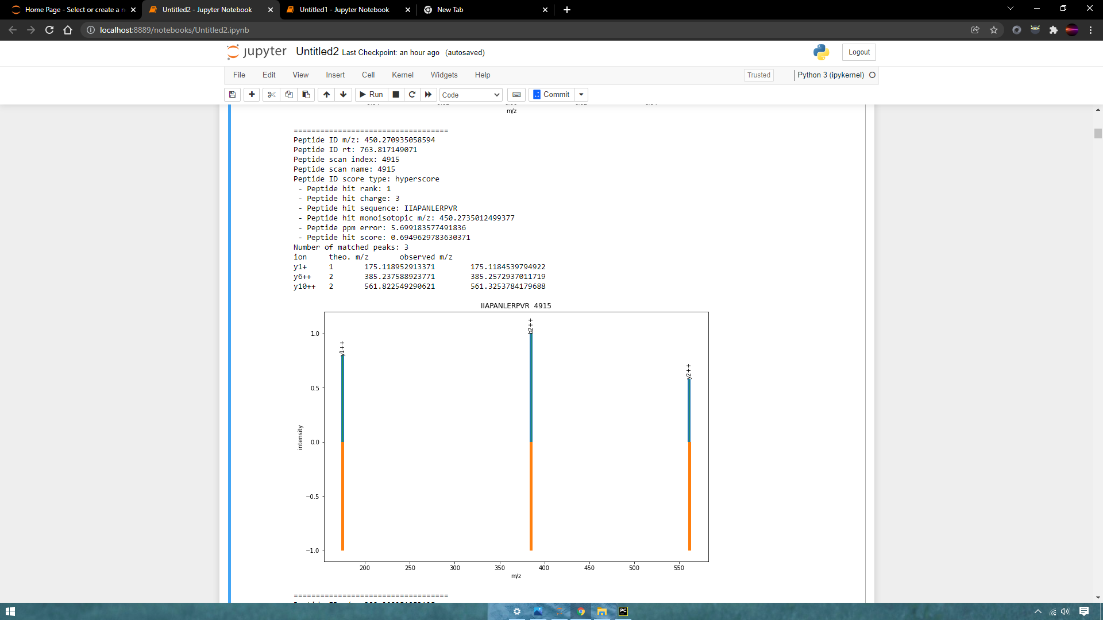

Slide 37
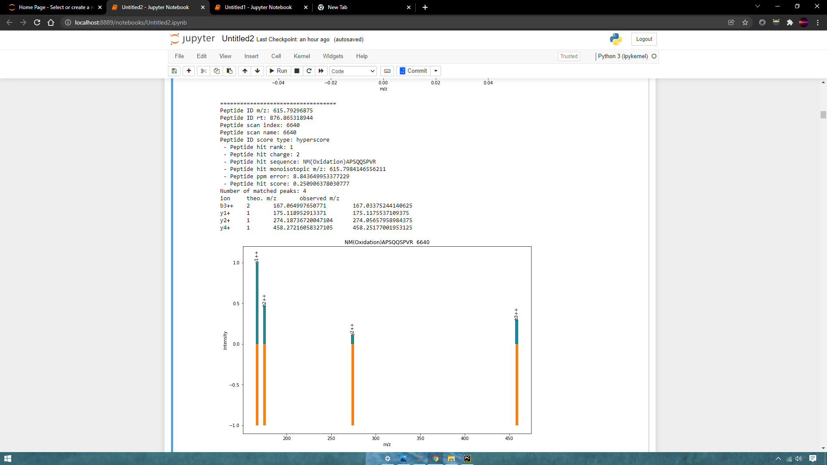

Slide 38
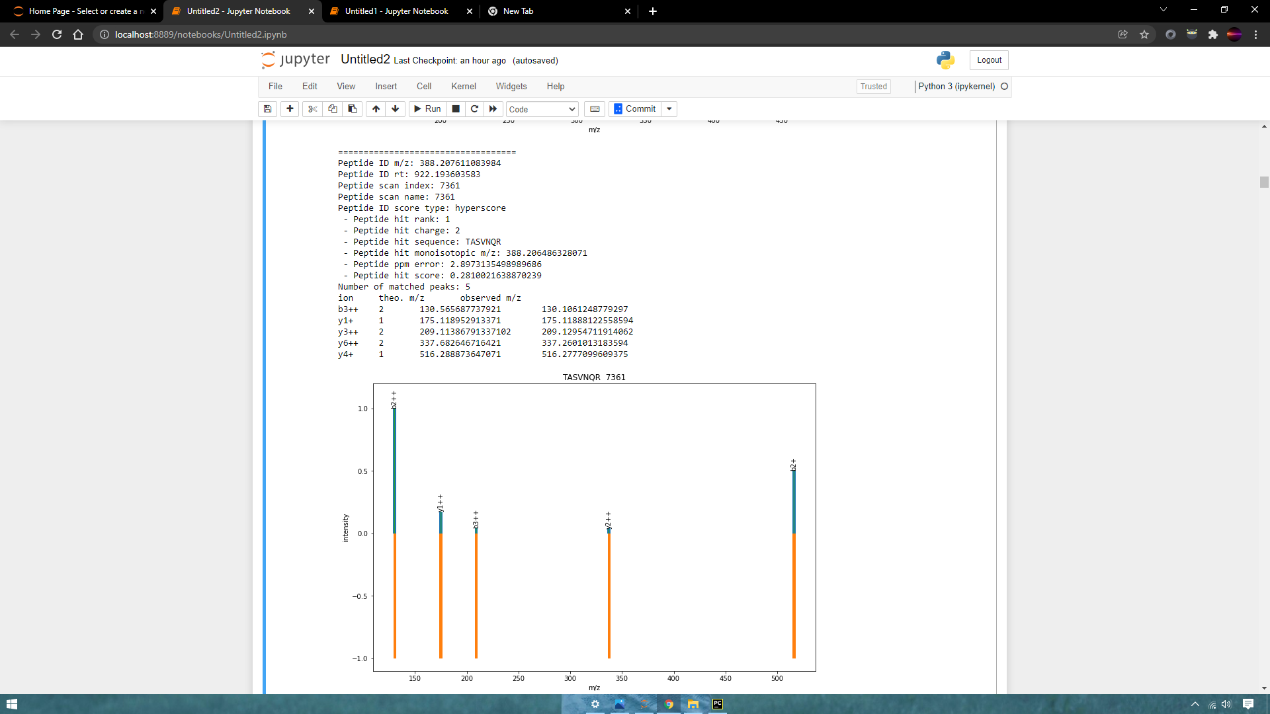

Slide 39
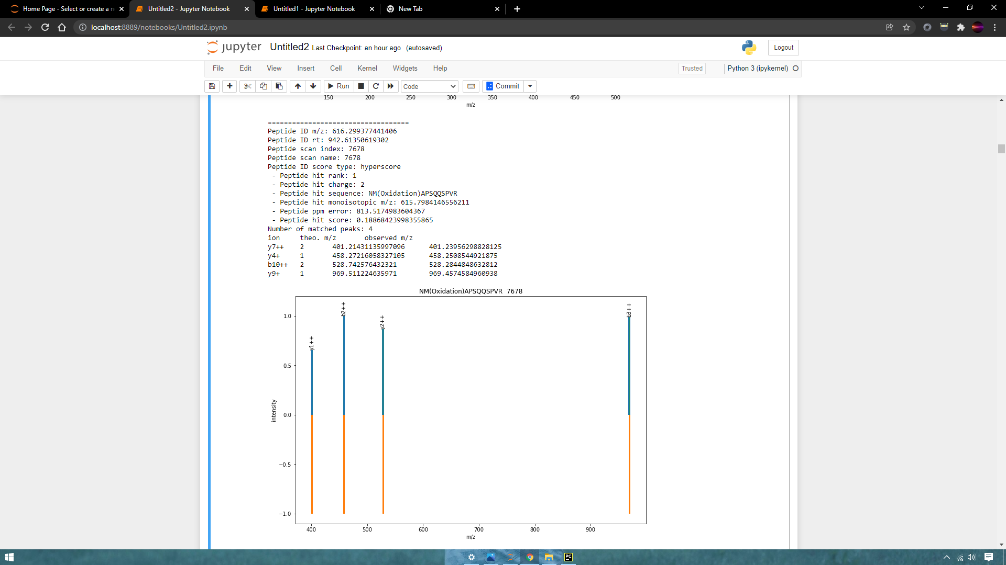
File:20201019_Syam_Spl6

Slide 40


Slide 41



Slide 42


Slide 43

File:20201019_Syam_Spl7

Slide 44



Slide 45


Slide 47



Slide 48


File:0201019_Syam_Spl9

Slide 49


Slide 50


Slide 51


Slide 52


File:SCLC-Urine-ConA-4

Slide 53


Slide 58

File:SCLC-Urine-ConA-8

Slide 59


Slide 60


Slide 61



Slide 62



Slide 63


File:SCLC-Urine-ConA-5

Slide 64



Slide 65



Slide 66



Slide 67



Slide 68


Prostate
File:20180326_CAINO_01_band04

Slide 69



Slide 70



Slide 71



Slide 72



Slide 73



Slide 74



Slide 75


File:PC_F7-1

Slide 76



Slide 77



Slide 78



Slide 79



Slide 80



Slide 81



Slide 82



Slide 83



Slide 84


File:PC_F8-2

Slide 85



Slide 86



Slide 87



Slide 88



Slide 89



Slide 90



Slide 91



Slide 92



Slide 93


